Slide 1
EOSDIS
FY2011
Annual Metrics Report
Prepared By:
Hyo Duck Chang Adnet, Inc.
Brian Krupp Adnet, Inc.
Lalit Wanchoo Adnet, Inc.
February 2012

Slide 2
Preface
The Earth Sciences Data and Information System (ESDIS) Project (Code 423) is pleased to present the following report on metrics from across the Earth Observation System Data and Information System (EOSDIS). The 12 Data Centers of EOSDIS support different scientific disciplines and provide an individualized set of products and services to their science community and the public. Although discipline oriented, the data centers engage in common data management functions of ingest, archive and distribution, as well as describing their data and services on web sites. Metrics are collected on a daily basis from each data center. The ESDIS Project collects these metrics in a tool called the ESDIS Metrics System (EMS). Data center analysts can view their detailed metrics to assess internal performance and trends. The ESDIS Project combines these metrics, not for comparisons between the data centers, but as a system level view of EOSDIS performance. This report provides snapshots of metrics as the combination of the individual data centers and from a purely system perspective. During FY2011, it was observed that ASF distribution included a large number of the bots-distributions (downloads by Internet search engines for indexing purposes) and those bots distributions were excluded in the ASF metrics. ASF also made changes to its reporting during FY2011. These changes and the migration of historical data to the new operating system contribute to a significant increase in archive volume. Updates for Ingest and Archive were not available for this report; however, the report includes an estimate of the Total Archive showing a significant increase. New for FY2011 is the CDDIS archive information which became available in December 2010. In keeping with previous years, and in order to support trend comparisons, the metrics data are presented on a fiscal year basis, not by calendar year. If you have any questions or comments please contact Jeanne Behnke at (301) 614-5326 or jeanne.behnke@nasa.gov or Kevin Murphy at (301) 614-5580 or kevin.j.murphy@nasa.gov.

Slide 3
Introduction
This report presents statistics on data metrics and web activities at the EOSDIS data centers during Fiscal Year 2011 (October 1, 2010 through September 30, 2011) from the Earth Science Data and Information System (ESDIS) Metrics System (EMS).
EMS supports the ESDIS project management by collecting and organizing various metrics from the Earth Observing System (EOS) Data and Information System (DIS) Data Centers and other Data Providers. The EMS collects and presents data on the usage of products and services delivered via the Internet or managed in EOSDIS archives.
EMS consists of a Data Metrics component and a Web Metrics component. The Data Metrics component provides statistics on data ingest, archive and distribution plus data users profile information collected from Data Providers. The Web Metrics component provides statistics on web site visits, views and visitors with a variety of related parameters.
This report contains tables and graphs of FY2011 statistics and comparisons to previous years. Values for previous fiscal years are produced from EMS unless noted otherwise. Summary tables, text, graphs, and more detailed statistics tables are also included. As for FY2010, this year's report has separate metrics for the Near-Real Time (NRT) and CALIPSO products. It is important to note that metrics for the NRT and CALIPSO products are not used in the distribution trend analyses presented in this report. It is also important to note that all bots-related distributions (downloads by Internet search engines for indexing purposes) are excluded in the ASF metrics.
Definitions for terms used in this report can be found in the Definitions worksheet.

Slide 4
Summary
Unique Data Sets: Total number of unique data sets distributed in the fiscal year.
Distinct Users of EOSDIS Data and Services: Total unique users across EOSDIS Data Users and Web Visitors, per data center and summed
Web Site Visits: Sum of web visits for data centers where a visit represents a user session not broken by more than 30 minutes and a duration of at least one minute
Average Archive Growth: Sum across reporting data centers of the data volume added to the individual archives divided by the days in the year
Total Archive Volume: Sum across reporting data centers of the data volumes in the archive as of end of the fiscal year
End User Distribution Products: Total number of products distributed from all reporting data centers
End User Average Distribution Volume: Sum across reporting data centers of the data volume distributed for the fiscal year divided by the days in the year

Slide 5
Data Metrics
Ingest
Archive
Total Archive
Data Users
  Distinct Users
  Repeat Users
  Top 20 Countries
  Foreign Distribution
  Distribution
    By Data Center
    Volume by Domain
    Products by Domain
    Near Real-time Products
    CALIPSO Products
    Top 20 Countries
    Top 10 Products
    Unique Product Count

Slide 6
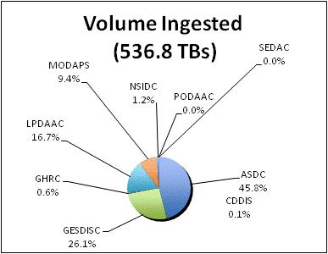
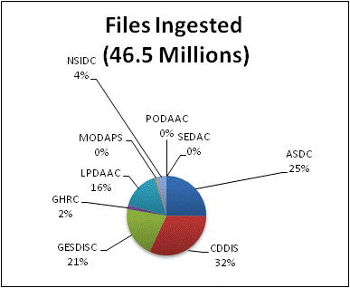
Ingest
Ingest is the amount of data coming into a data center over a period of time and includes all product levels. For this report, the data is presented as the amount of data entered into each data center during FY2011. The sum of all data centers is the total ingest for EOSDIS. OBPG and ORNL do not provide ingest metrics.
Note: ASF ingest data for FY2011 is not considered accurate as of the publication of this report and is excluded in the report.

Slide 7
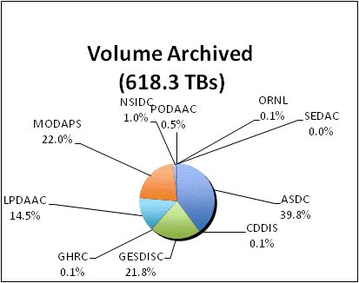
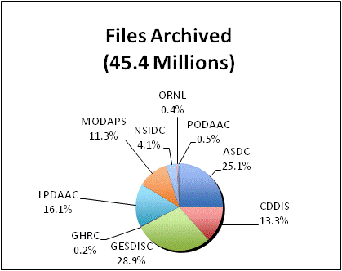
Archive
Archive is the amount of data added to the archive over a period of time and includes all products levels. Archive metrics for CDDIS, OBPG and NSIDC V0 are not available at this time.
Note: ASF archive data for FY2011 is not considered accurate as of the publication of this report and is excluded in the report.

Slide 8
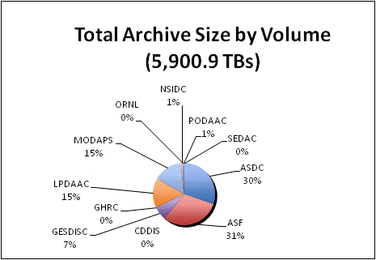
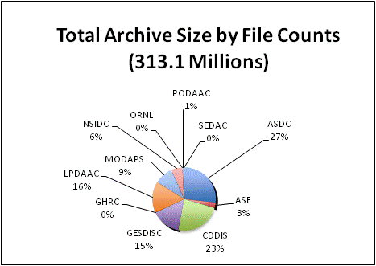
Total Archive Size
The Total Archive Size describes the EOSDIS archive at the end of FY2011. This includes all data (including ancillary) but not data marked for deletion.
* Archive values were provided by ASDC
** In FY2011, ASF changed the method of managing their archive. Data for this report is based on a February 21, 2012 e-mail from ASF staff.
*** CDDIS archive size was derived from the archive values (6.22 TB, 78,635,159 files) as of 3/6/2012 given by CDDIS

Slide 9
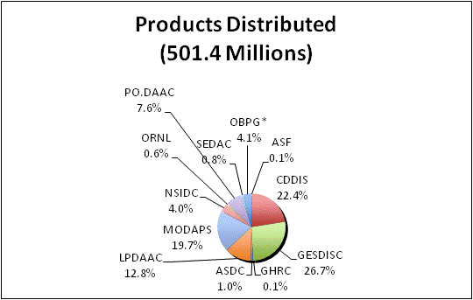
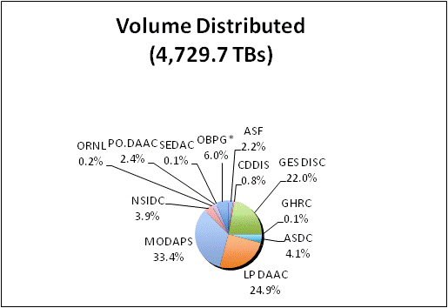
Distribution By Data Center
Distribution presents the amount of data successfully distributed to Public Users.
* OBPG data taken from the Ocean Color Website

Slide 10
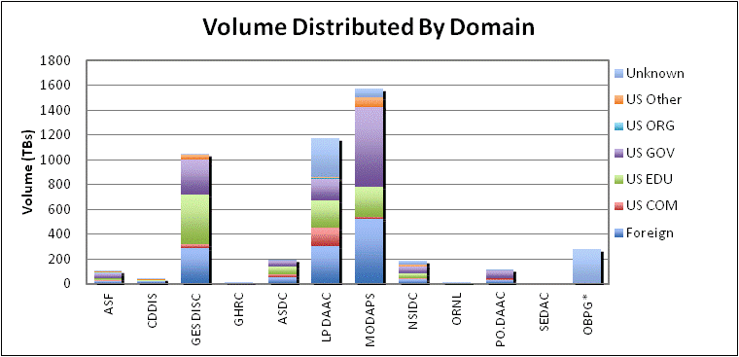
Volume Distributed By Domain
Volume Distribution presents the volume of data successfully distributed to Public Users by Domain.
* OBPG data taken from the Ocean Color Website

Slide 11
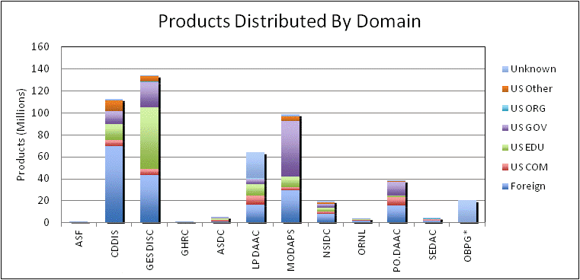
Product Distribution By Domain
Product Distribution presents the number of products successfully distributed to Public Users by Domain.
* OBPG data taken from the Ocean Color Website

Slide 12
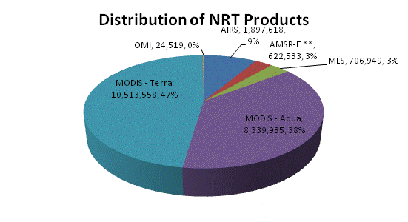
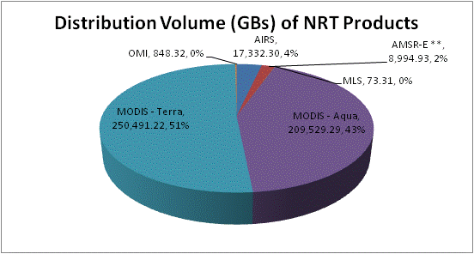
Distribution of NRT Products
Near Real-time (NRT) Distribution provides the amount of data successfully distributed to registered users of the Land Atmosphere Near Real-time Capability for EOS (LANCE). LANCE provides access to near real-time data (<3 hours from observation) from MODIS, AMSR-E, AIRS, MLS and OMI instruments. Metrics for distribution volume, numbers of files distributed and users are presented.
* Excludes metadata
** Includes the NRT products from GHRC and MODAPS

Slide 13
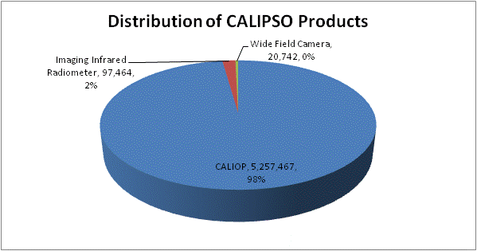
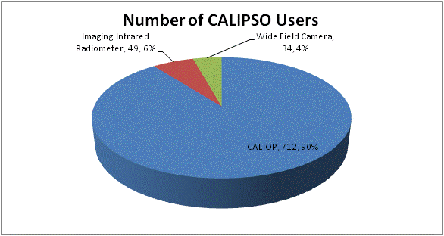
Distribution of CALIPSO Products
Although not an EOSDIS supported mission, the Cloud-Aerosol Lidar and Infrared Pathfinder Satellite Observations (CALIPSO) is an Earth science mission with data available through the Atmospheric Sciences Data Center (ASDC) at NASA Langley Research Center. The tables below provide distribution statistics particular to CALIPSO. These statistics are not included in the EOSDIS totals.
* Excludes metadata

Slide 14
Data Distribution - Top 20 Countries
* Some products are inherently larger than other files in size and therefore may skew the results.
** When counting # of files, metadata files are not included.

Slide 15
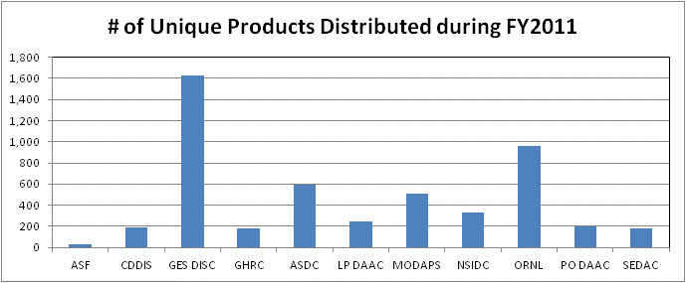
Distribution of Unique Data Products
Tables below show the number of unique data products distributed to public users during FY2011. In counting unique products, metadata were excluded. Also excluded are the NRT and CALIPSO products.
* OBPG is not included since no product information is available.

Slide 16
Data Distribution - Top 10 Products
* Some products are inherently larger than other files in size and therefore may skew the results.
** When counting # of files, metadata files are excluded.

Slide 17
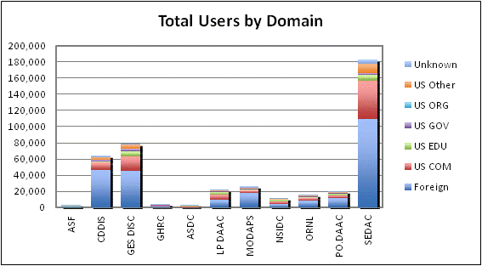
Distinct Data Users
Distinct Data Users presents the number of distinct public users* who received data product files.
* Does not include OBPG users

Slide 18
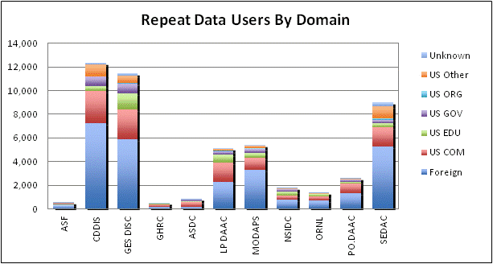
Repeat Data Users
Repeat users are distinct Public users* who received data on more than one day in the fiscal year.
* Does not include OBPG users

Slide 19
Data Users - Top 20 Countries

Slide 20
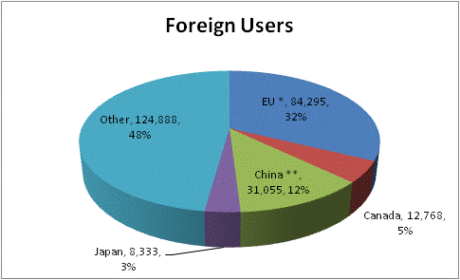
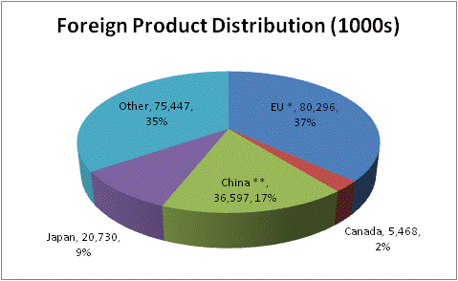
Foreign Distribution
Distribution metrics for foreign public users are compared. Statistics are based on country information provided by 11 EOSDIS data centers.
* EU includes 27 European Union member countries.
** China includes only People’s Republic of China and does not include Taiwan or Hong Kong.

Slide 21
Web Metrics
Visitors and Visits
Repeat Visitors
Top 20 Domains
Top 20 Countries

Slide 22
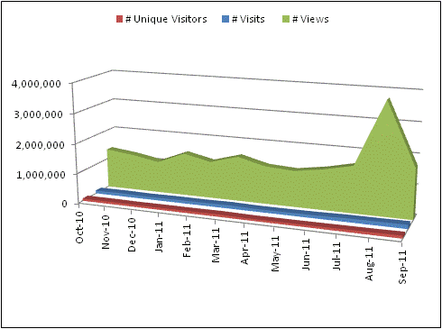
Web Visitors and Visits
EOSIDS web activity is measured by the number of Visits made, the number of pages Viewed and the number of distinct Visitors. Visits, Views, and Visitors count visits greater than or equal to 1 minute. Visits of at least one minute are considered to represent significant work accomplished, and many of the shorter visits are of less than a second. Data came from 11 data centers (these data centers are listed in Slide #17).

Slide 23
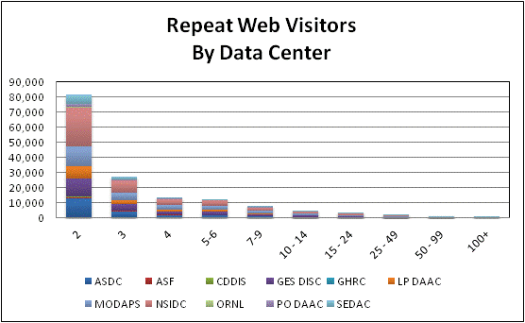
Repeat Web Visitors
EOSDIS Web Visitors are characterized by the number of visits they make and how frequently they return. Visitors counted in the table below are those that stayed for one minute or more. Repeat Visitors are counted from the start of the Fiscal Year.
FY2011 Web Visitors for Visits of one minute or more

Slide 24
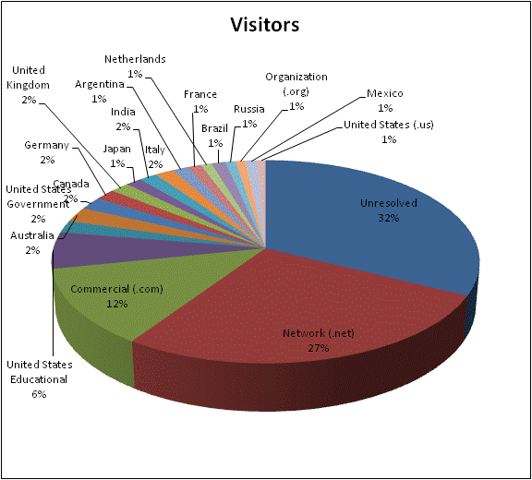
Top 20 Domains By # of Web Visitors
The FY2011 Top 20 Domains for visits >= 1 minute is sorted by the # of Visitors. Data came from 11 data center s (these data centers are listed in Slide #17). All statistics are based on domains resolved by NetInsight, using host information.

Slide 25
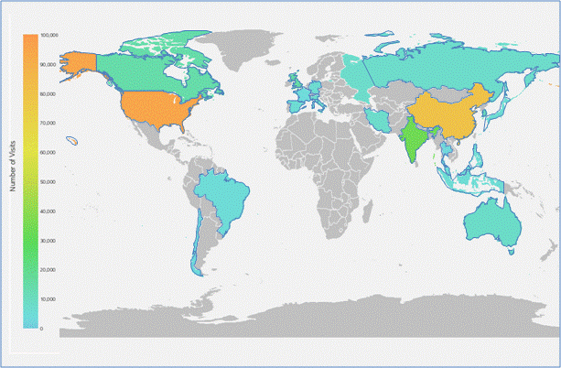
Top 20 Countries By # Web Visits
The FY2011 Top 20 Countries for visits >= 1 minute is sorted by the # of Visits. Data came from 11 data center s (these data centers are listed in Slide #17). All statistics are based on country information resolved by NetInsight.

Slide 26
Total Users and Trends
Total Users
Data Volume Distribution Trend
Data Product Distribution Trend
Top 10 Products Trend FY2010-FY2011
Known U.S. - Foreign Product Distribution Trend
Web Trends (Visits and Visitors)

Slide 27
Total Users
Total Users is an estimate formed by combining the distinct Data Users and distinct Web Visitors, removing the overlap. The common element for these counts is the IP address (Host); therefore, the comparison is made without using the additional details provided by the Data User email address or the Web Visitor browser. Not being able to compare the users directly likely results in an undercount. Web Visitors included in the count are for those visitors with visits of one minute or longer. To minimize the undercount, the final Total Users value includes the total Web Visitors (IP address plus browser), plus the distinct Data Users (counted by IP Address).

Slide 28
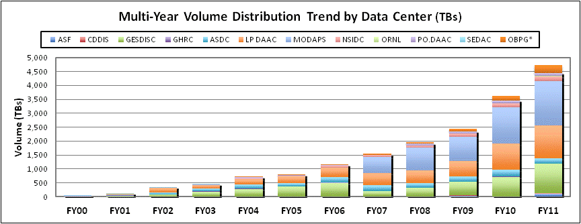
Data Volume Distribution Trend
The Volume Distribution Trend presents distributed volume counts from EMS by data center.
OBPG distribution metrics from the Ocean Color web site are included beginning in FY2004. CDDIS data became available in FY2009.

Slide 29
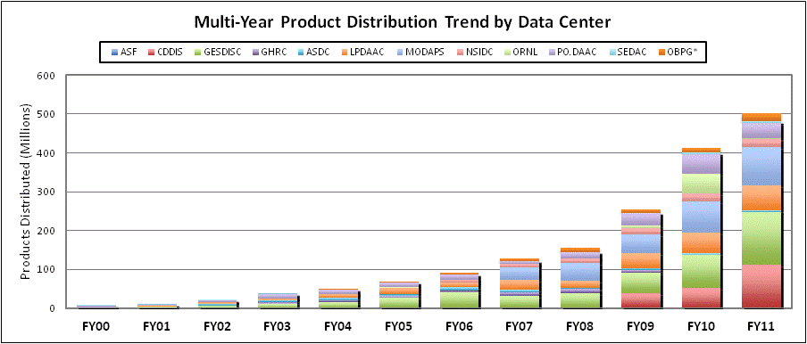
Data Product Distribution Trend
The Product Distribution Trend presents distributed product counts from EMS by data center.
OBPG distribution metrics from the Ocean Color web site are included beginning in FY2004. CDDIS data became available in FY2009.

Slide 30
Top 10 Products Trend by Volume
FY2010 – FY2011
*Some products are inherently larger than other files in size and therefore may skew the results.

Slide 31
Top 10 Products Trend by # of Files
FY2010 – FY2011
** When counting # of files, metadata files are not included.

Slide 32
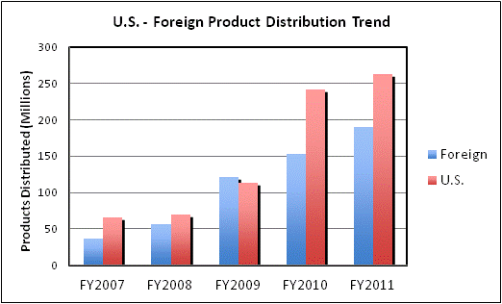
Known U.S. – Foreign
Product Distribution Trend
Note: Metrics do not include product distribution where the destination country could not be determined. Also excluded are the ocean products from OBPG for which country information is not available.

Slide 33
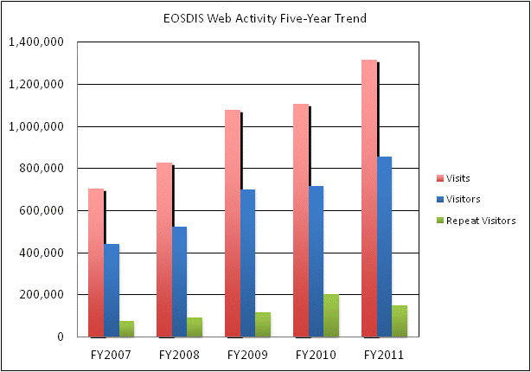
Web Trends
Web metrics data for EOSDIS became available as of FY2007. Data for FY2007 is complete for 7 and FY2008 is complete for 8 of the 11 data centers providing the metrics for FY2009 and FY2010. During FY11, all 11 data centers provided metrics. These web metrics are for visits of one minute or more.

Slide 34
Definitions (1 of 3)

Slide 35
Definitions (2 of 3)

Slide 36
Definitions (3 of 3)

