Slide 1
EOSDIS
FY2009
Annual Metrics Report
Prepared By:
Hyo Duck Chang Adnet, Inc.
Brian Krupp Adnet, Inc.
Lalit Wanchoo Adnet, Inc.
March 2010

Slide 2
Preface
The Earth Sciences Data and Information System (ESDIS) Project (Code 423) is pleased to present the following report on metrics from across the Earth Observation System Data and Information System (EOSDIS). The 12 Data Centers of EOSDIS support different scientific disciplines and provide an individualized set of products and services to their science community and the public. Although discipline oriented, the data centers engage in common data management functions of ingest, archive and distribution, as well as describing their data and services on web sites.
Metrics are collected on a daily basis from each data center. The ESDIS Project collects these metrics in a tool called the ESDIS Metrics System (EMS). Data center analysts can view their detailed metrics to assess internal performance and trends. The ESDIS project combines these metrics, not for comparisons between the data centers, but as a system level view of EOSDIS performance. This report provides snapshots of metrics as the combination of the individual data centers and from a purely system perspective.
The EOSDIS Annual Report for FY2009 (Oct. 1, 2008 – Sept. 30, 2009) presents a best effort to combine and present information from the collected metrics data. Some data centers are in the process of developing their interfaces with the EMS and testing is not yet complete. Therefore, some data centers do not yet deliver metrics data in all parameter categories – these will be added in future reports.
In keeping with previous years, and in order to support trend comparisons, the metrics data are presented on a fiscal year basis, not by calendar year.
If you have any questions or comments please contact Jeanne Behnke at (301) 614-5326 or jeanne.behnke@nasa.gov or Kevin Murphy at (301) 614-5580 or kevin.j.murphy@nasa.gov.

Slide 3
Introduction
This report presents statistics on data metrics and web activity at the EOSDIS data centers during Fiscal Year 2009 (October 1, 2008 through September 30, 2009) from the Earth Science Data and Information System (ESDIS) Metrics System (EMS).
EMS supports the ESDIS project management by collecting and organizing various metrics from the Earth Observing System (EOS) Data and Information System (DIS) Data Centers and other Data Providers. The EMS collects and presents data on the usage of products and services delivered via the Internet or managed in EOSDIS archives.
EMS consists of a Data Metrics component and a Web Metrics component. The Data Metrics component provides statistics on data ingest, archive and distribution plus data users profile information collected from Data Providers. The Web Metrics component provides statistics on web site visits, views and visitors with a variety of related parameters.
This report contains tables and graphs of FY2009 statistics and comparisons to previous years. Values for previous fiscal years are produced from EMS. Summary tables, text, graphs, and more detailed statistics tables are also included.
Definitions for terms used in this report can be found at the end of this presentation.

Slide 4
Summary
Unique Data Sets: Total number of unique data sets distributed in the fiscal year
Distinct Users of EOSDIS Data and Services: Total unique users across EOSDIS Data Users and Web Visitors, per data center and summed
Web Site Visits: Sum of web visits for data centers where a visit represents a user session not broken by more than 30 minutes and a duration of at least one minute
Average Archive Growth: Sum across reporting data centers of the data volume added to the individual archives divided by the days in the year
Total Archive Volume: Sum across reporting data centers of the data volumes in the archive as of end of the fiscal year
End User Distribution Products: Total number of products distributed from all reporting data centers
End User Average Distribution Volume: Sum across reporting data centers of the data volume distributed for the fiscal year divided by the days in the year

Slide 5
Data Metrics
Ingest
Archive
Total Archive
Data Users
  Distinct Users
  Repeat Users
  Top 20 Countries
  Distribution
    By Data Center
    Volume by Domain
    Products by Domain
    Top 20 Countries
    Top 10 Products

Slide 6
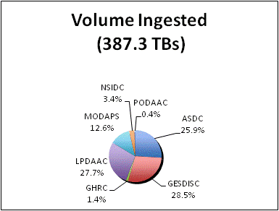
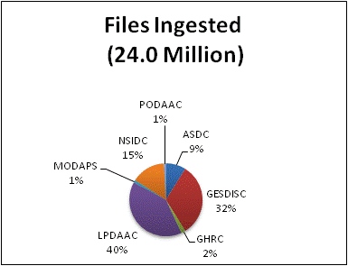
Ingest
Ingest is the amount of data coming into a data center over a period of time and includes all product levels. For this report, the data is presented as the amount of data entered into each data center during FY2009. The sum of all data centers is the total ingest for EOSDIS. Only the major contributors (excluding LaTIS which is not available) are included in the count.

Slide 7
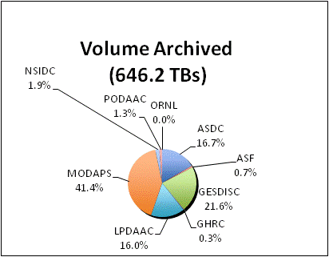
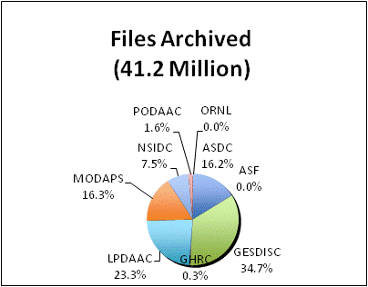
Archive
Archive is the amount of data added to the archive over a period of time and includes all products levels. SEDAC values represent very small amounts of data and are not counted. LaTIS, OBPG, and CDDIS data are not available at this time.

Slide 8
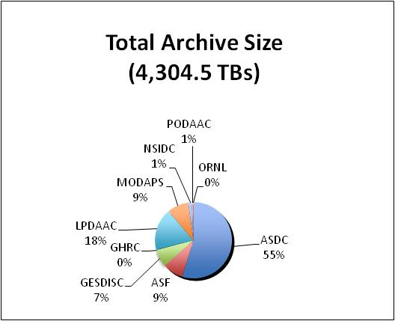
Total Archive Size
The Total Archive Size describes the EOSDIS archive at the end of FY2009. These data account for all data (including ancillary data) but not data marked for deletion.

Slide 9
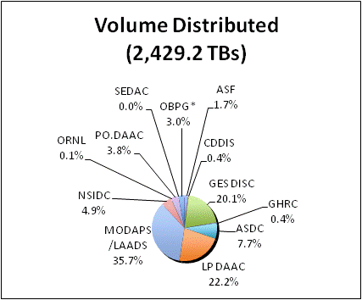
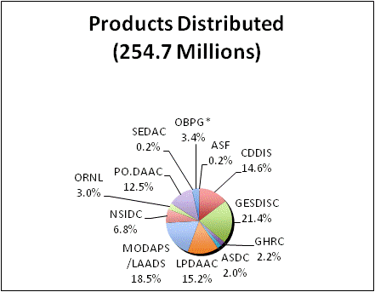
Distribution By Data Center
Distribution presents the amount of data successfully distributed to Public Users.
*OBPG data taken from the Ocean Color web site

Slide 10
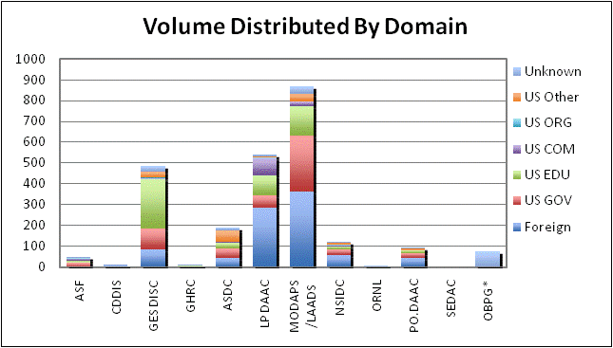
Volume Distribution By Domain
Volume Distribution presents the volume of data successfully distributed to Public Users by Domain.
*OBPG data taken from the Ocean Color web site

Slide 11
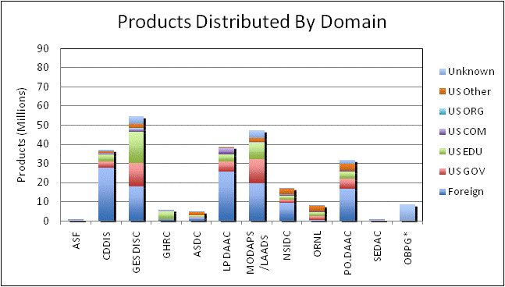
Product Distribution By Domain
Product Distribution presents the number of products successfully distributed to Public Users by Domain.
*OBPG data taken from the Ocean Color web site

Slide 12
Data Distribution - Top 20 Countries
* Some products are inherently larger than other files in size and therefore may skew the results.
** When counting # of files, metadata files are not included.

Slide 13
Data Distribution - Top 10 Products
* Some products are inherently larger than other files in size and therefore may skew the results.
** When counting # of files, metadata files are not included.

Slide 14
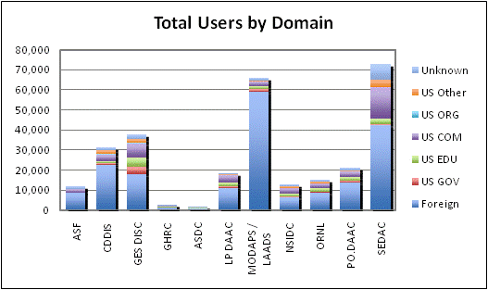
Distinct Data Users
Distinct Data Users presents the number of distinct public users* who received data product files.
* Does not include OBPG users

Slide 15
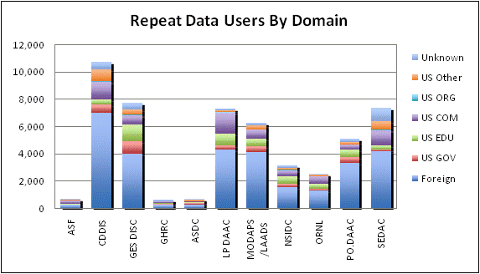
Repeat Data Users
Repeat users are distinct Public users* who received data on more than one day in the fiscal year.
* Does not include OBPG users

Slide 16
Data Users - Top 20 Countries

Slide 17
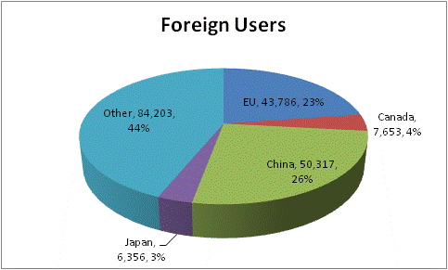
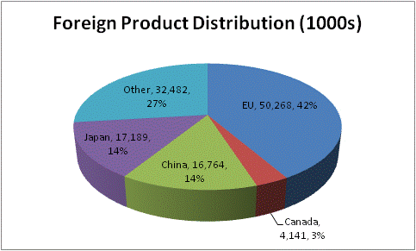
Foreign Distribution
EU includes 27 European Union member countries.
China includes only People’s Republic of China and does not include Taiwan.

Slide 18
Web Metrics
Visitors and Visits
Repeat Visitors
Top 20 Domains
Top 20 Countries

Slide 19
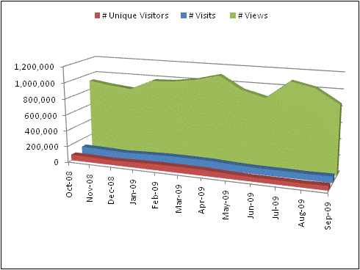
Web Visitors and Visits
EOSIDS web activity is measured by the number of Visits made, the number of pages Viewed and the number of distinct Visitors. Visits, Views, and Visitors count visits greater than or equal to 1 minute. Visits of at least one minute are considered to represent significant work accomplished, and many of the shorter visits are of less than a second.

Slide 20
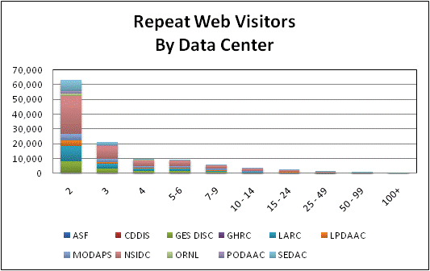
Repeat Web Visitors
EOSDIS Web Visitors are characterized by the number of visits they make and how frequently they return. Visitors counted in the table below are those that stayed for one minute or more. Repeat Visitors are counted from the start of the Fiscal Year.
FY2009 Web Visitors for Visits of one minute or more

Slide 21
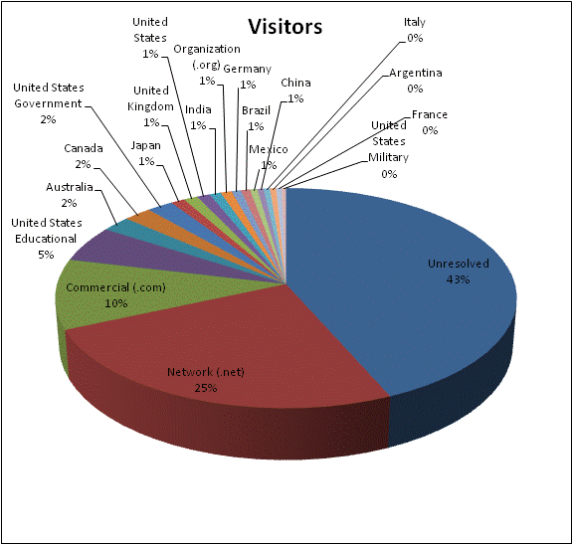
Top 20 Domains By # Web Visitors
The FY2009 Top 20 Domains for visits >= 1 minute is sorted by the # of Visitors. Domains are as defined by NetInsight.

Slide 22
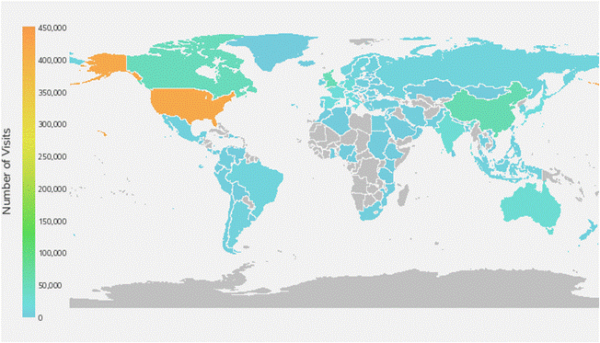
Top 20 Countries By # Web Visits
The FY2009 Top 20 Countries for visits >= 1 minute is sorted by the # of Visits.

Slide 23
Total Users and Trends
Total Users
Data Volume Distribution Trend
Data Product Distribution Trend
Top 10 Products Trend FY2008-FY2009
Known U.S. - Foreign Product Distribution Trend
Web Trends (Visits and Visitors)

Slide 24
Total Users
Total Users is an estimate formed by combining the distinct Data Users and distinct Web Visitors, removing the overlap. The common element for these counts is the IP address (Host); therefore, the comparison is made without using the additional details provided by the Data User email address or the Web Visitor browser. Not being able to compare the users directly likely results in an undercount. Web Visitors included in the count are for those visitors with visits of one minute or longer. To minimize the undercount, the final Total Users value includes the total Web Visitors (IP address plus browser), plus the distinct Data Users (counted by IP Address).

Slide 25
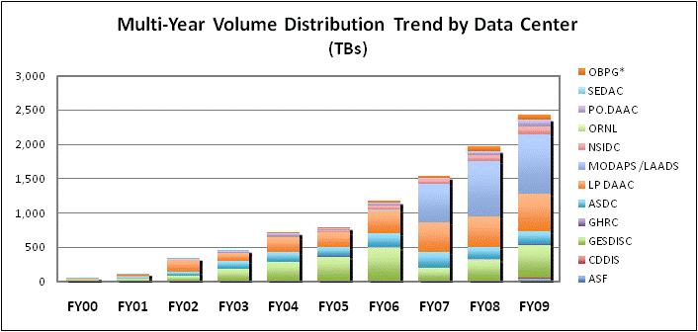
Data Volume Distribution Trend
The Volume Distribution Trend presents distributed volume counts from EMS by data center.
OBPG* distribution metrics from the Ocean Color web site are included beginning in FY2004.

Slide 26
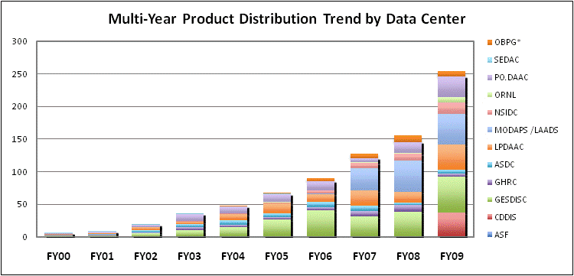
Data Product Distribution Trend
The Product Distribution Trend presents distributed product counts from EMS by data center.
OBPG* distribution metrics from the Ocean Color web site are included beginning in FY2004.

Slide 27
Top 10 Products Trend by Volume
FY2008 – FY2009
*Some products are inherently larger than other files in size and therefore may skew the results.

Slide 28
Top 10 Products Trend by #Files
FY2008 – FY2009
When counting # of files, metadata files are not included.

Slide 29
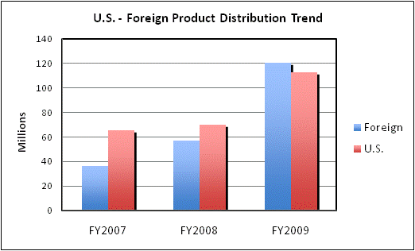
Known U.S. - Foreign Product Distribution Trend
* Does not include product distribution where the destination could not be determined

Slide 30
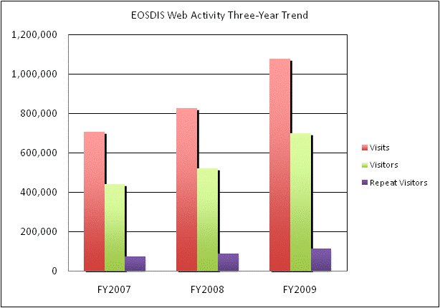
Web Trends
Web metrics data for EOSDIS became available as of FY2007, providing only one previous year to assess trends. Data for FY2007 is complete for 7 and FY2008 is complete for 8 of the 11 data centers providing metrics for FY2009. These web metrics are for visits of one minute or more.

Slide 31
Definitions (1 of 2)

Slide 32
Definitions (2 of 2)

