Slide 1
IOP algorithm workshop @ OOXX
Jeremy Werdell & Bryan Franz
NASA Ocean Biology Processing Group
25 Sep 2010, Anchorage, AK
http://oceancolor.gsfc.nasa.gov/WIKI/GIOP.html

Slide 2
3 goals for this workshop:
(1) receive feedback on the implementation of GIOP within l2gen and the analysis tools developed for algorithm evaluation
(2) identify metrics for evaluating algorithm performance
(3) outline a strategy to support in/output of uncertainties

Slide 3
goal (1): receive feedback on the implementation of GIOP within l2gen and the analysis tools developed for algorithm evaluation
we will review the:
status of GIOP implementation within l2gen
preliminary configuration of GIOP
analysis tools available for algorithm evaluation
questions for the working group:
what additional enhancements should be made to GIOP?
what weaknesses exist in the current implementation?
what additional analysis tools should be developed?

Slide 4
goal (2): identify metrics for evaluating algorithm performance
the working group will:
define a series of metrics for algorithm skill assessment
questions for the working group:
if we reconfigure GIOP, how do we know if this configuration is better or worse than an alternative configuration?
what combination of data products and spectral ranges should be considered in this evaluation process?

Slide 5
goal (3): outline a strategy to support in/output of uncertainties
the working group will:
identify and discuss methods for including uncertainties within an algorithm (input R_{rs} uncertainties, output IOP uncertainties)
questions for the working group:
what statistics/metrics are reported by existing methods and what are their meanings (what do they tell us)?
what methods can be implemented in the short term?
what methods require additional investigation or information?

Slide 6
GIOP framework
Lee et al. 2002
Morel f/Q - or -
Gordon quadratic
Levenberg-Marquardt
Amoeba (downhill simplex)
SVD matrix inversion
LUD matrix inversion

Slide 7
GIOP framework
tabulated b_{bp}*
power-law with:
fixed exponent
Lee (QAA)
Ciotti
Morel
Hoge & Lyon
Loisel & Stramski
fixed M_{bp}b_{bp}* from:
QAA
Loisel & Stramski
tabulated a_{dg}* exponential with:
fixed exponent
Lee (QAA)
OBPG
tabulated a_{φ}*(λ)
Ciotti a_{φ}*(λ)
Bricaud a_{φ}*(λ)

Slide 8
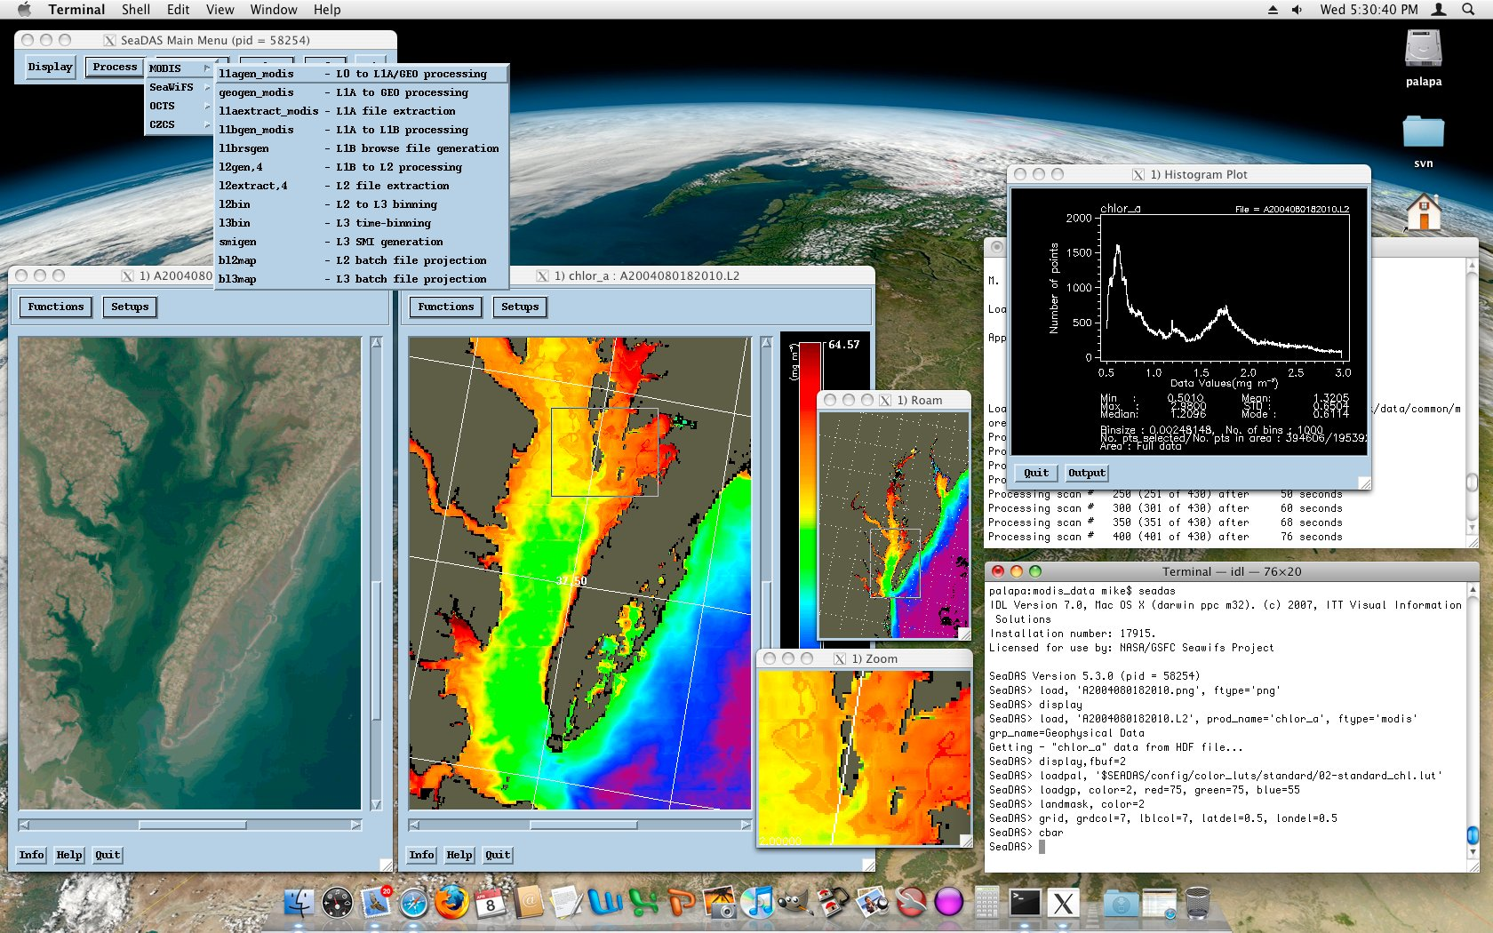
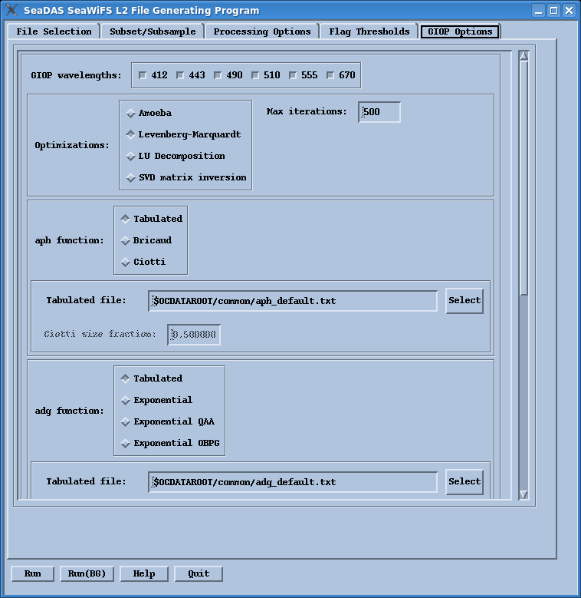
GIOP in SeaDAS

Slide 9
GIOP Baseline Configuration (PQN)
R_{rs}[0+] to r_{rs}[0-] via Lee et al. 2002
AOP to IOP via Morel f/Q, input Chl from empirical OCx
a_{ph}* via Bricaud et al. 1995, input Chl from empirical OCx
a_{dg}* via exponential with fixed exponent S_{dg}=0.018
b_{bp}* via power-law with exponent derived via Lee et al. 2002
Levenberg-Marquardt optimization
All wavelengths 400 – 700 nm included in optimization

Slide 10
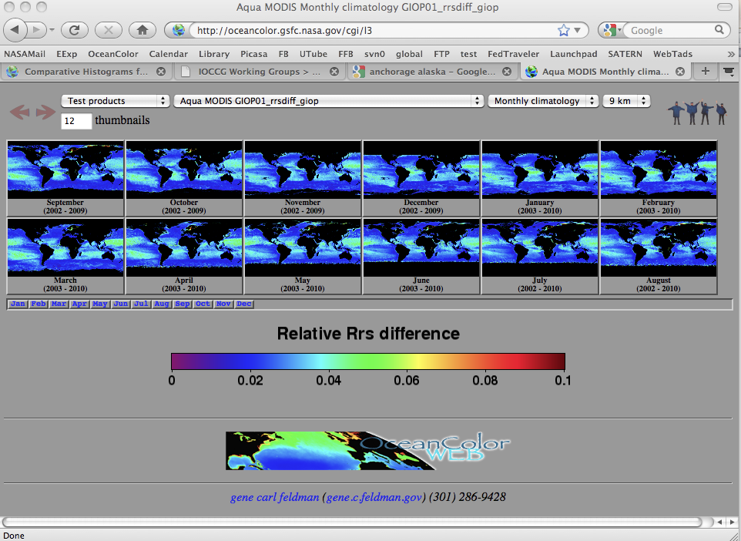
GIOP(PQN) test products available
for SeaWIFS and MODIS Aqua, from standard Level-3 dailies
composited to 8-day, monthly, seasonal
binned products and SMI maps at 9 and 4km
Chl
a(443)
a(555)
b_{b}(443)
b_{b}(555)
a_{ph}(443)
a_{ph}(555)
a_{dg}(443)
S_{dg}
b_{bp}(443)
S_{bp}
Δr_{rs}

Slide 11
features in the queue to be added to GIOP:
a_{w} and b_{bw} dependence on T and S
Lee et al. (1998) tunable a_{ph}
IOP-based AOP to IOP method(s)
updated Loisel and Stramski (?)
uncertainties

Slide 12
analyses and tools for evaluating algorithm performance:
match-ups:
NOMAD, IOCCG synthetic data set, SeaWiFS/Aqua match-ups
scatter plots, frequency distributions, regression statistics
modeled vs. measured goodness of fit
satellite Level-2 and -3 time-series and frequency distributions:
satellite-to-in situ, satellite-to-satellite
Level-2 regional series (9 regions)
Level-3 global and trophic-level series (oligo, meso, eutrophic)

Slide 13
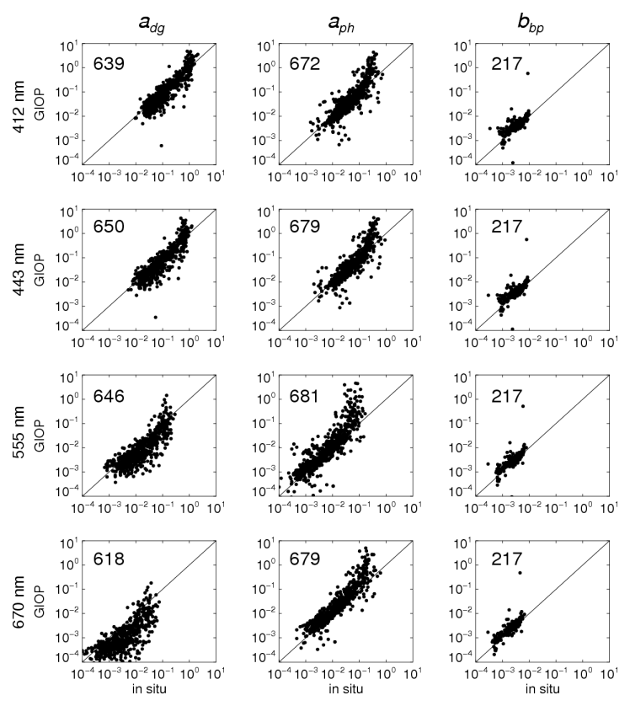
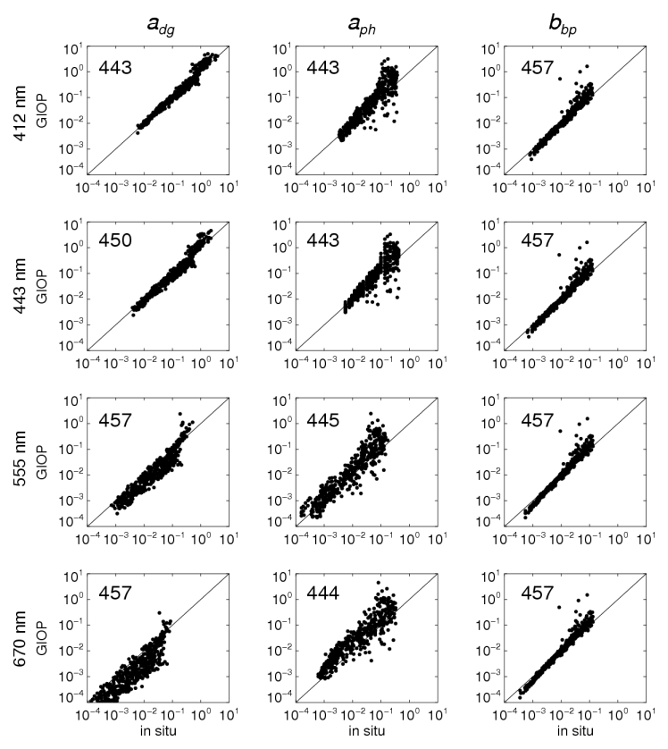
match-ups: http://oceancolor.gsfc.nasa.gov/cgi/giopval.cgi
scatter plots, modeled vs. measured
NOMAD IOCCG

Slide 14
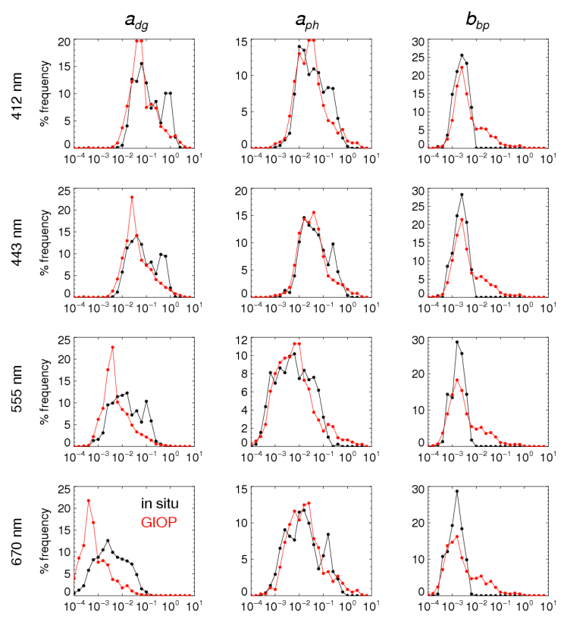
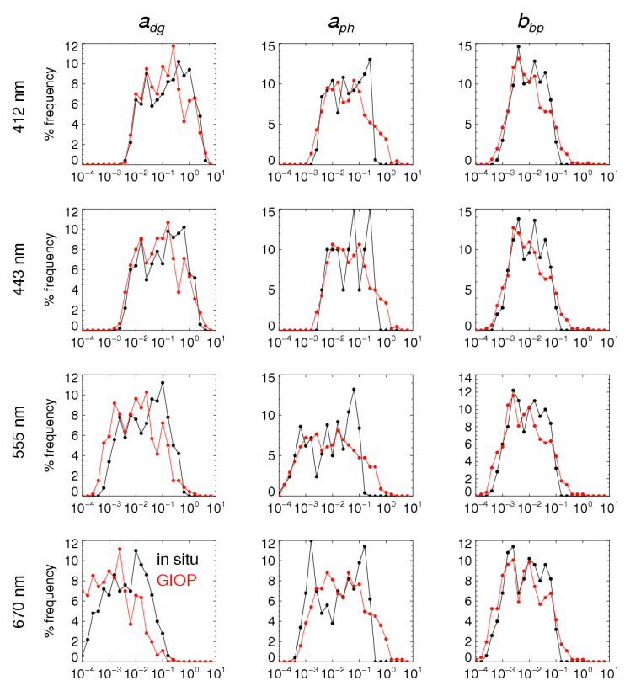
match-ups: http://oceancolor.gsfc.nasa.gov/cgi/giopval.cgi
frequency distributions, modeled vs. measured
NOMAD IOCCG

Slide 15
mean relative difference (Δ) as a measure of goodness of fit:
for R_{rs}:
for IOPs (derived products):
calculated over 400 ≤ λ ≤ 600 nm

Slide 16
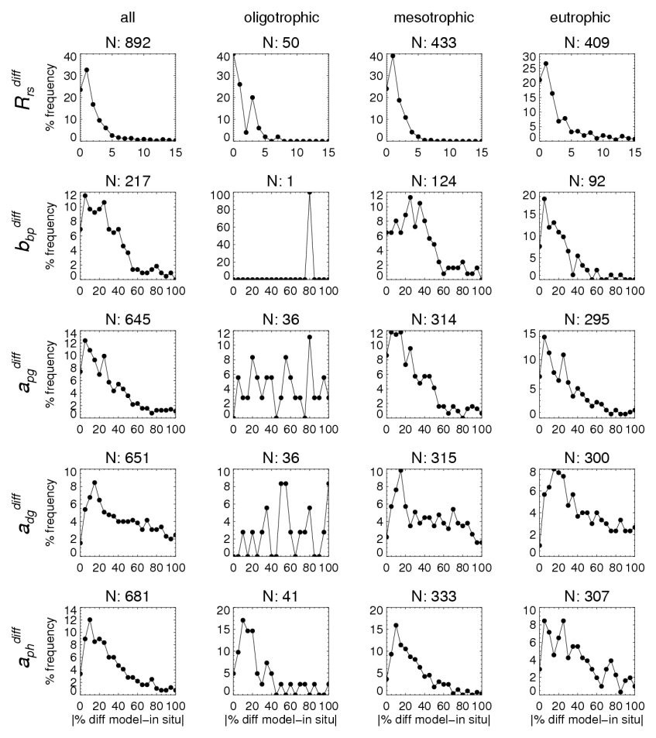
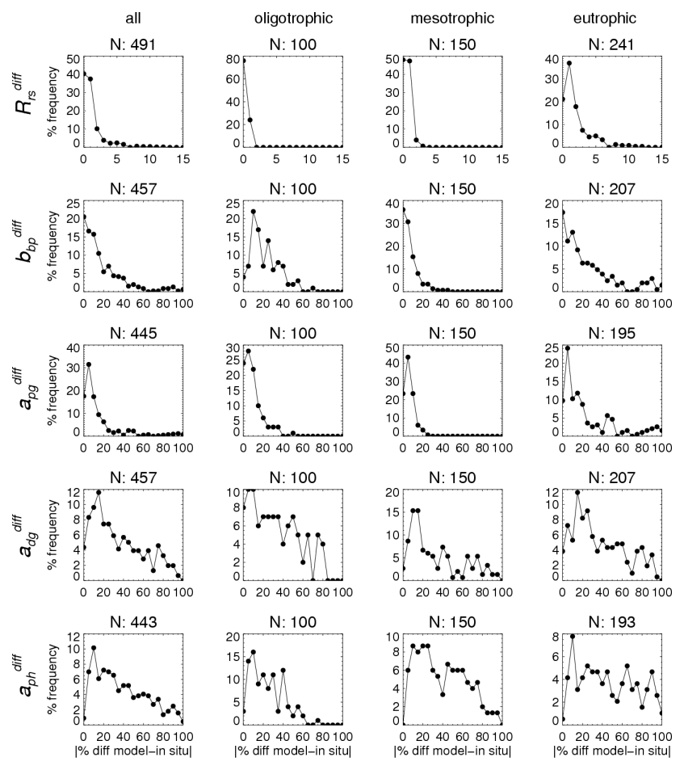
match-ups: http://oceancolor.gsfc.nasa.gov/cgi/giopval.cgi
average spectral differences, modeled vs. measured
NOMAD IOCCG
Δ Δ Δ Δ Δ Δ Δ Δ

Slide 17
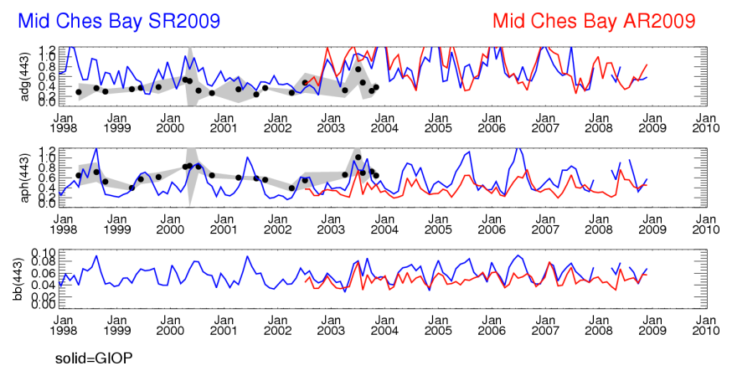
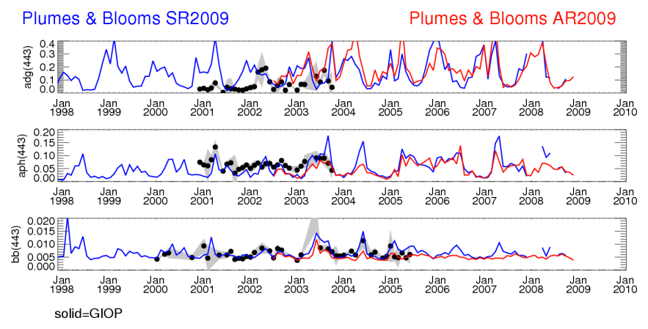
L2 time-series: http://oceancolor.gsfc.nasa.gov/WIKI/GIOPL2Regions.html

Slide 18
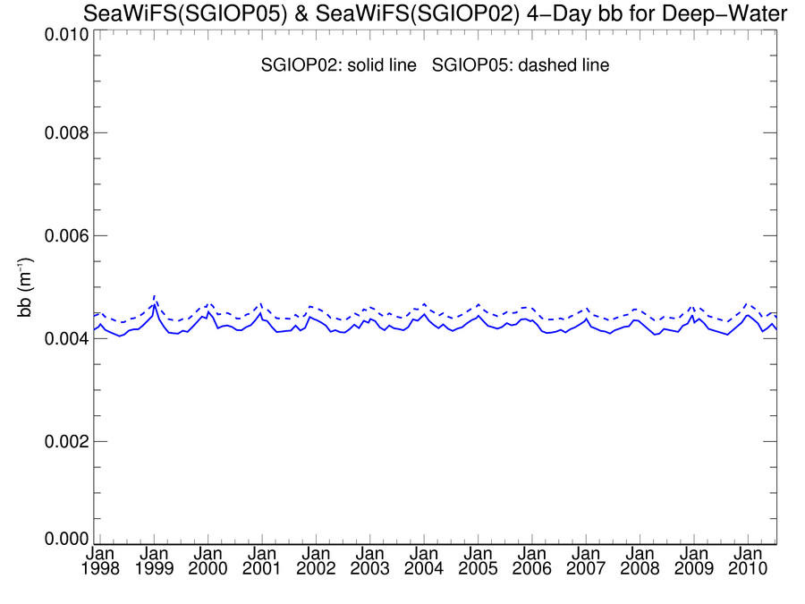
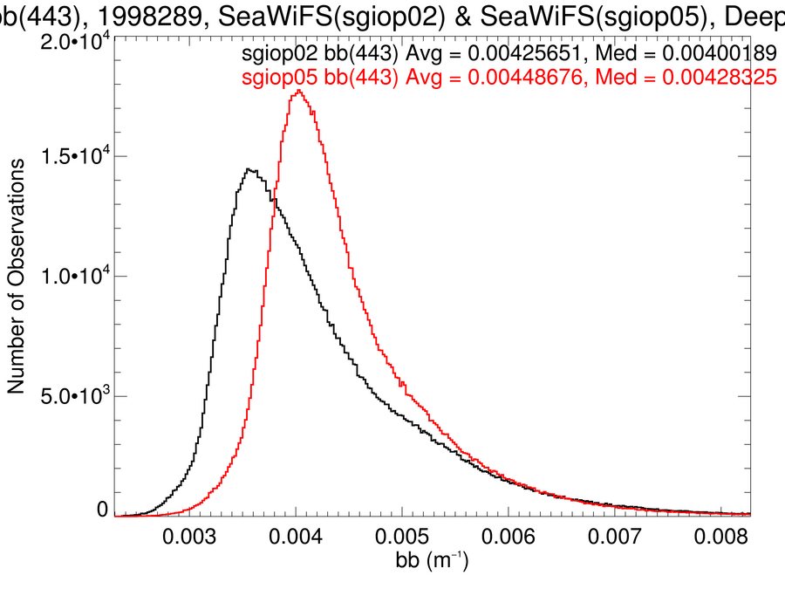
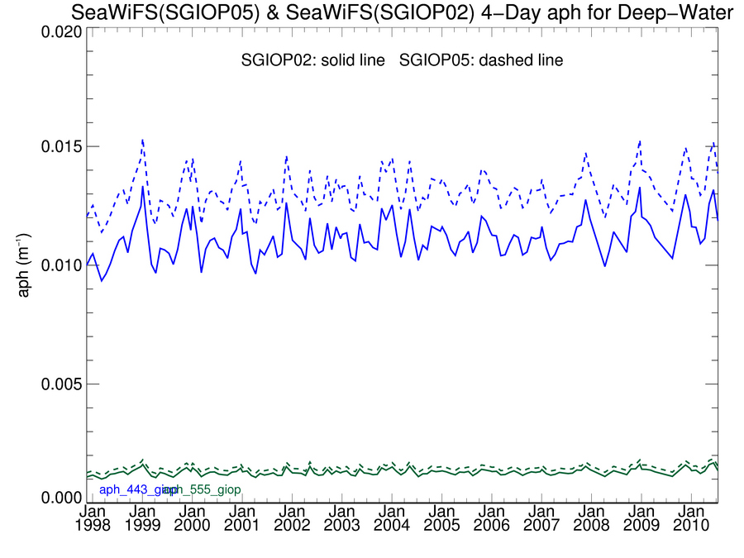
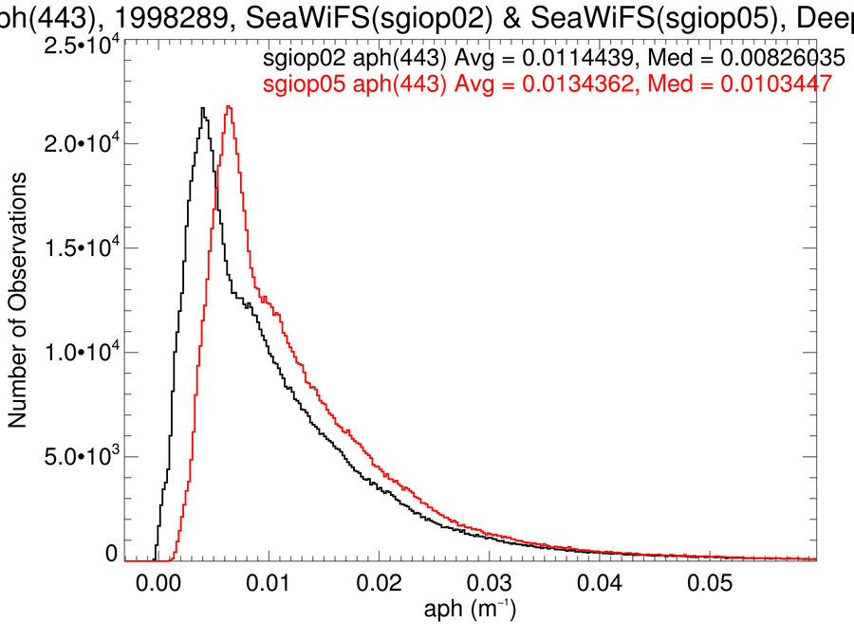
L3 time-series: http://oceancolor.gsfc.nasa.gov/WIKI/GIOPL3Global.html
b_{b}(443)
a_{ph}(443), a_{ph}(555) b_{b}(443)
a_{ph}(443)

Slide 19
other tools not shown:
Level-3 temporal anomalies
zonal Level-3 time-series (10° boxes from 60°N to 60°S)
possible additional validation results:
stratification of match-ups by solar and satellite geometries
attention to Level-2 and -3 coverages (sample sizes)

Slide 20
open discussion:
comments on the implementation of GIOP?
any features to be added to GIOP?
comments on the validation tools?

Slide 21
summary of comparisons to in situ/synthetic data:
dynamic range of all λ well represented, except at highest end
spectral biases in a_{dg} and a_{ph} (S_{dg}=0.018 too high?)
a_{dg} low, a_{ph} high in 0.05-0.2 m⁻¹ range
b_{bp} compares well

Slide 22
sensitivity analyses:
tools:
NOMAD, IOCCG synthetic data set
scatter plots, frequency distributions, regression statistics
modeled vs. measured goodness of fit
tests (run relative to baseline preliminary configuration):
R_{rs} transmission (spectrally flat 0.529 vs. spectral Lee function)
Morel f/Q vs. Gordon quadratic
Levenberg-Marquardt vs. matrix inversion
6 λ vs. 5 λ (no 670 nm)
vary a_{ph}: baseline (Bricaud) chl ±10%, ±33%; Ciotti (S_{f}=0.5); GSM
vary S_{dg}: baseline (0.018) ±10%, ±33%; QAA, OBPG
vary η: baseline (QAA) ±10%, ±33%

Slide 23
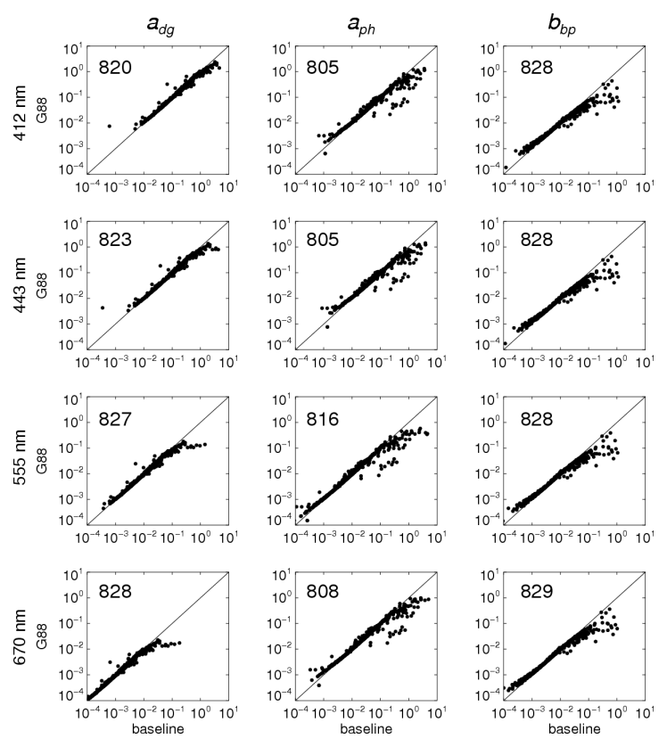
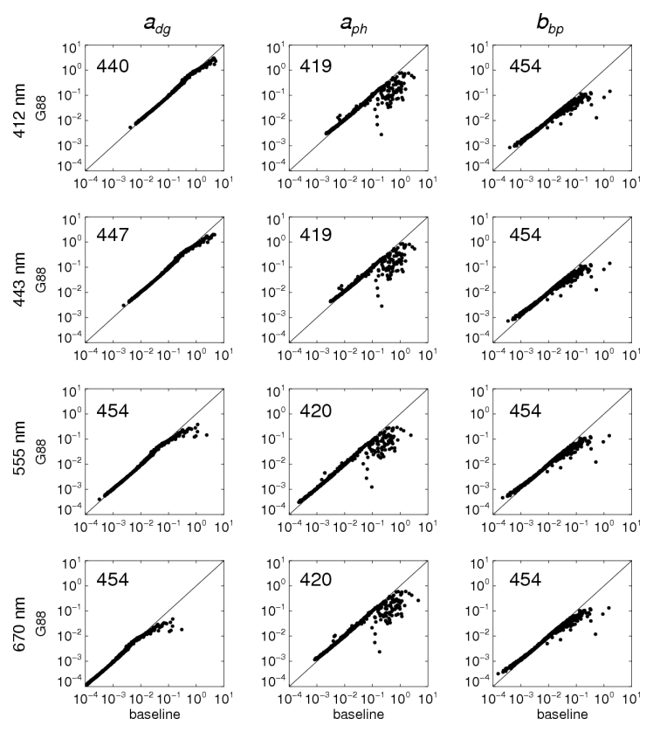
sensitivities: http://oceancolor.gsfc.nasa.gov/cgi/giopsens.cgi
scatter plots, baseline (Morel f/Q) vs. Gordon quadratic
NOMAD IOCCG

Slide 24
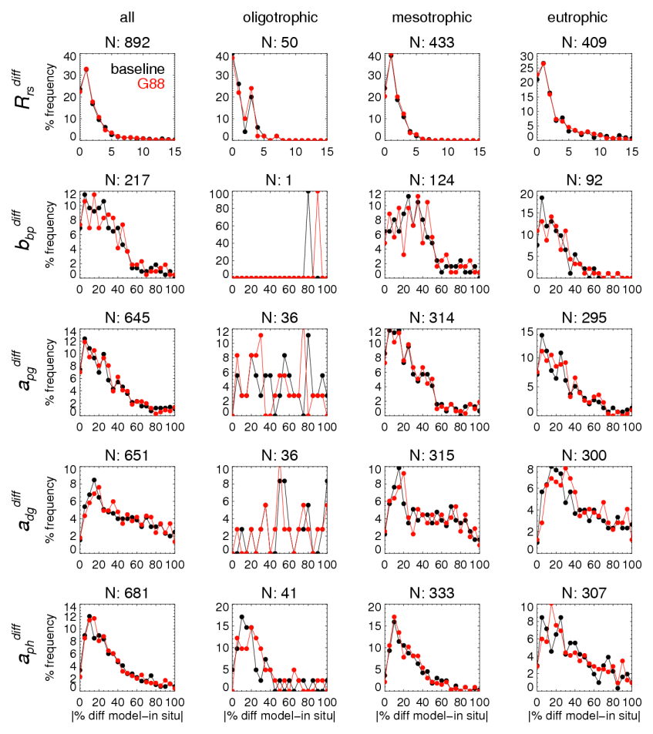
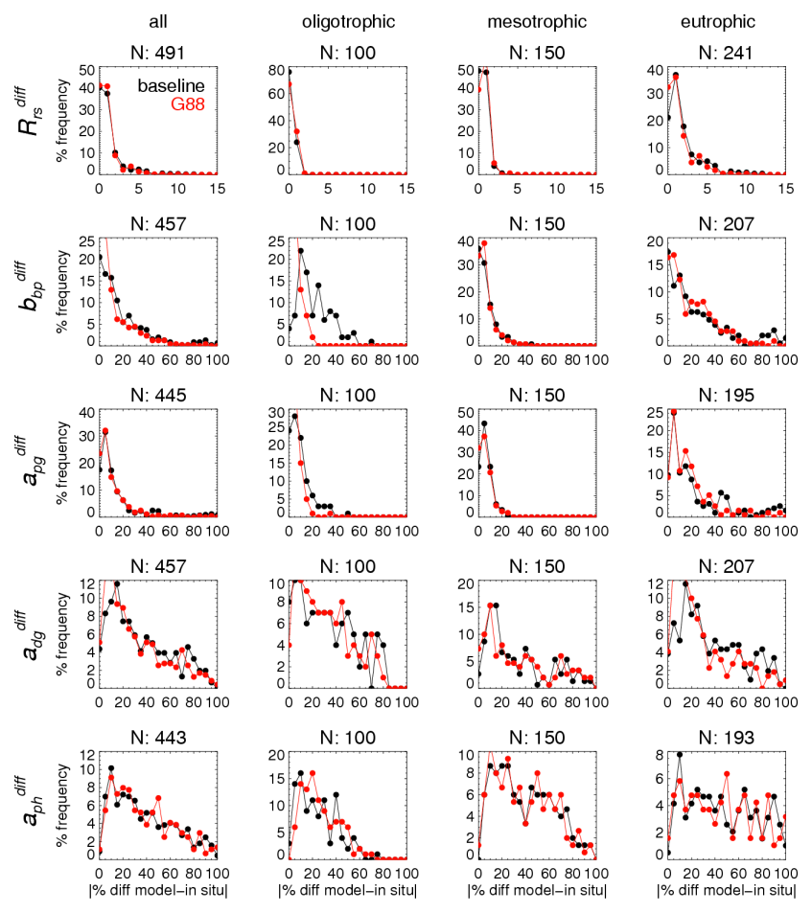
sensitivities: http://oceancolor.gsfc.nasa.gov/cgi/giopsens.cgi
average spectral differences, baseline (Morel f/Q) vs. Gordon quadratic
NOMAD IOCCG
Δ Δ Δ Δ Δ Δ Δ Δ

Slide 25
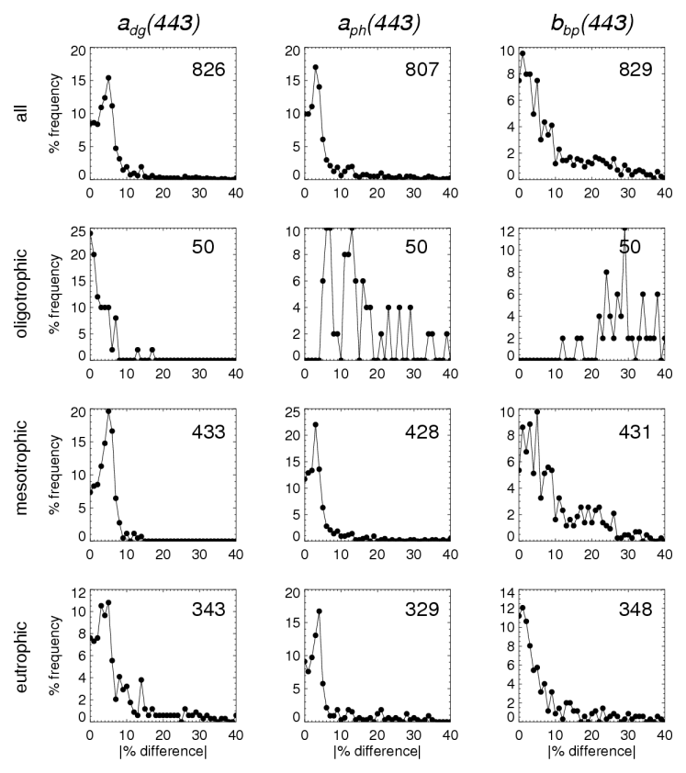
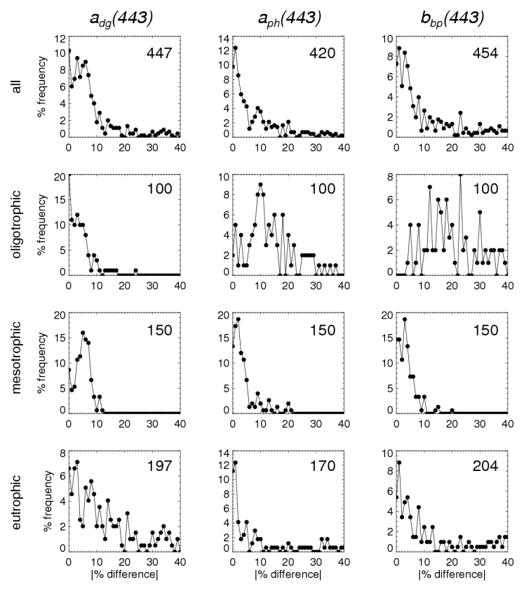
sensitivities: http://oceancolor.gsfc.nasa.gov/cgi/giopsens.cgi
absolute % differences, baseline (Morel f/Q) vs. Gordon quadratic
NOMAD IOCCG

Slide 26
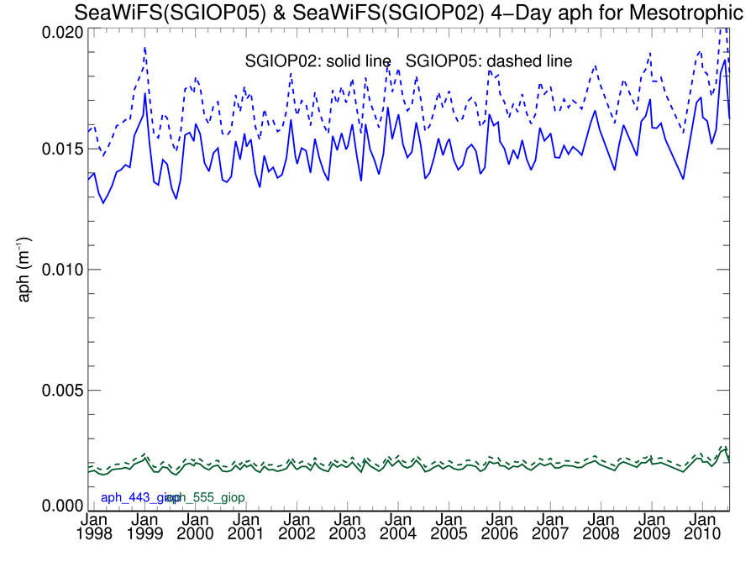
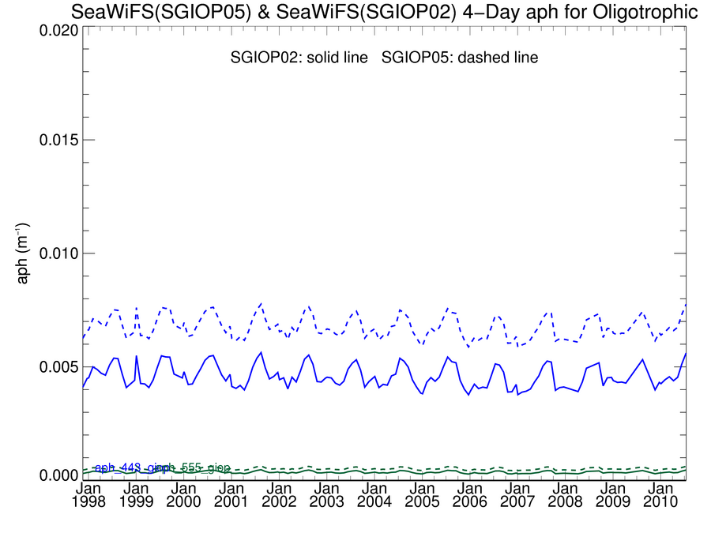
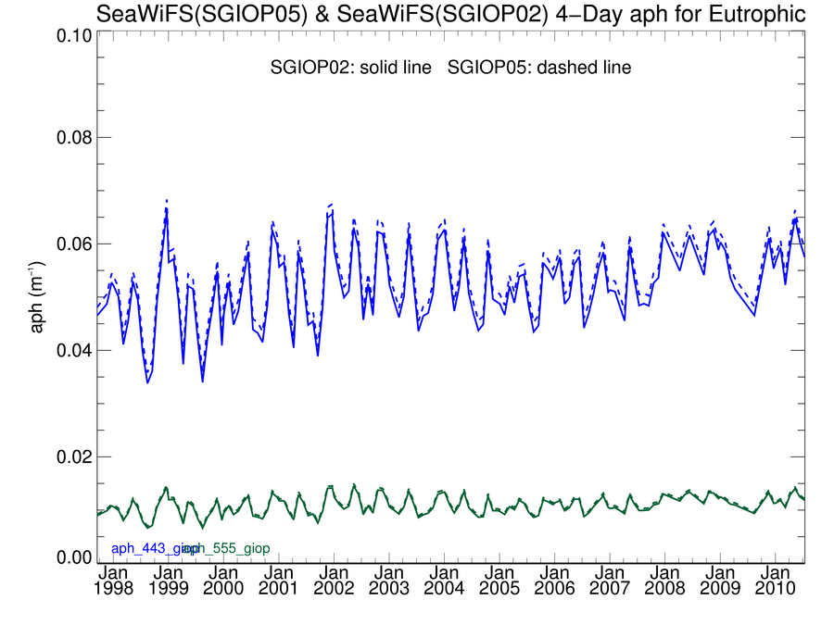
L3 time-series: http://oceancolor.gsfc.nasa.gov/WIKI/GIOPL3Global.html
Morel f/Q solid
Gordon quadratic dashed
a_{ph}(443), a_{ph}(555)
deep water
mesotrophic
oligotrophic
eutrophic

Slide 27
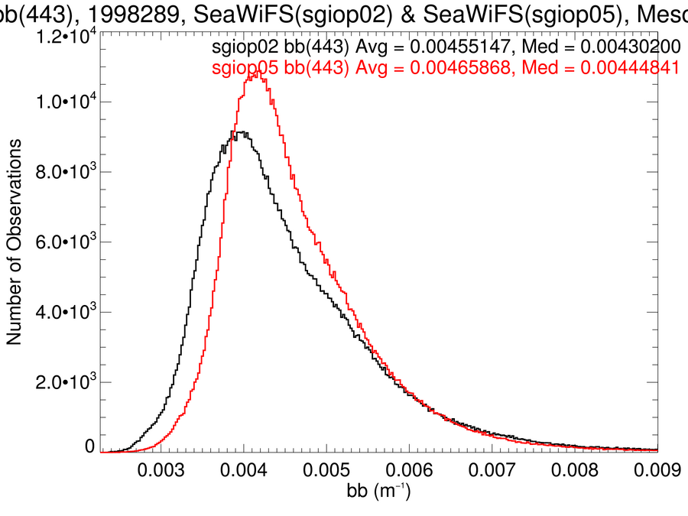
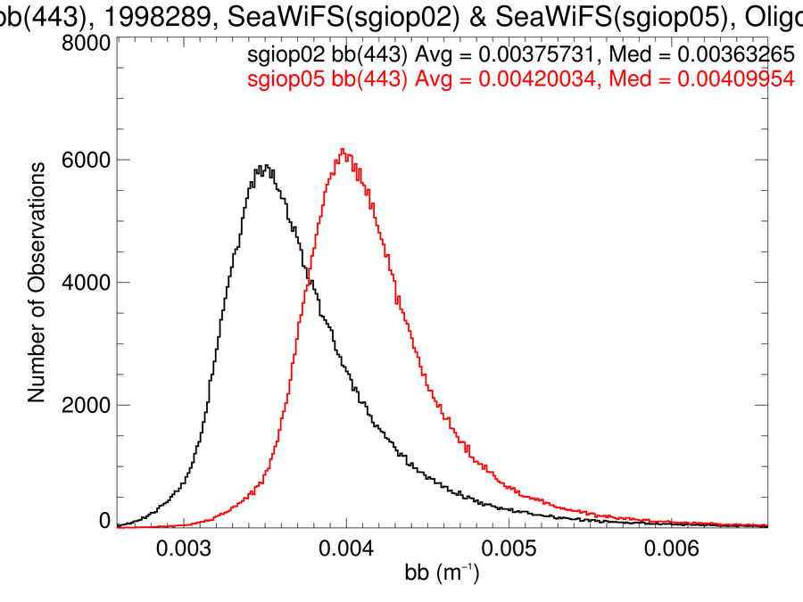
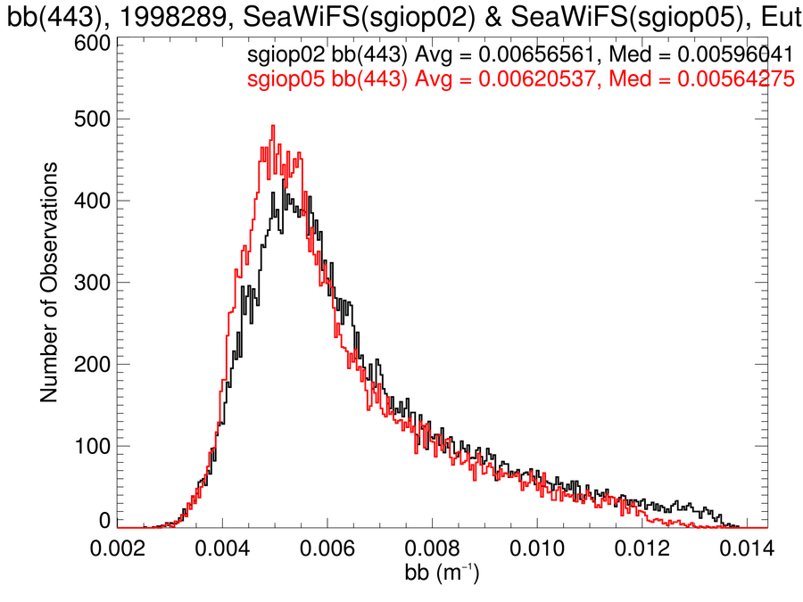
L3 time-series: http://oceancolor.gsfc.nasa.gov/WIKI/GIOPL3Global.html
Morel f/Q black
Gordon quadratic red
b_{b}(443)
deep water
mesotrophic
oligotrophic
eutrophic

Slide 28
hierarchical summary of sensitivity analyses:
tier 1 (very sensitive):
Levenberg-Marquardt vs. linear matrix inversion
a_{ph} from Ciotti (S_{f}=0.5) or GSM
S_{dg} ±33% or from OBPG algorithm
Morel f/Q vs. Gordon quadratic
tier 2 (sensitive, typically in particular parts of dynamic range):
6 λ vs. 5 λ
S_{dg} ±10% or from QAA
tier 3 (not sensitive):
transmission
Bricaud chl ±10% and ±33%;
η ±10% and ±33%
priority does not indicate better/worse performance, only that the baseline configuration is sensitive to the particular change

Slide 29
open discussion:
comments on the sensitivity analyses?
any analyses to be added?
Bryan and Jeremy are in the process of documenting these tests

Slide 30
interpreting the sensitivity analyses:
performance metrics:
defining a series of metrics for skill assessment
(no one leaves until we do this)
specific sensitivity analyses:
Morel f/Q vs. Gordon quadratic
Levenberg-Marquardt vs. linear matrix inversion
defining S_{dg} (static or dynamic?)

Slide 31
performance metrics:
data products, spectral ranges, metrics:
consider a_{dg}, a_{ph}, b_{bp} from 400 ≤ λ ≤ 700 nm (600 nm?)
minimize ΔR_{rs}
compare with ground truth (regression statistics, ΔIOP)
maintain sample sizes
trade-offs and issues:
excellence at 1 λ vs. lesser, but acceptable performance at all λ
performance over dynamic range of retrievals (global vs. coastal)
Improved performance vs. loss of sample sizes

Slide 32
sensitivities: http://oceancolor.gsfc.nasa.gov/cgi/giopsens.cgi
baseline (Morel f/Q) vs. Gordon quadratic

Slide 33
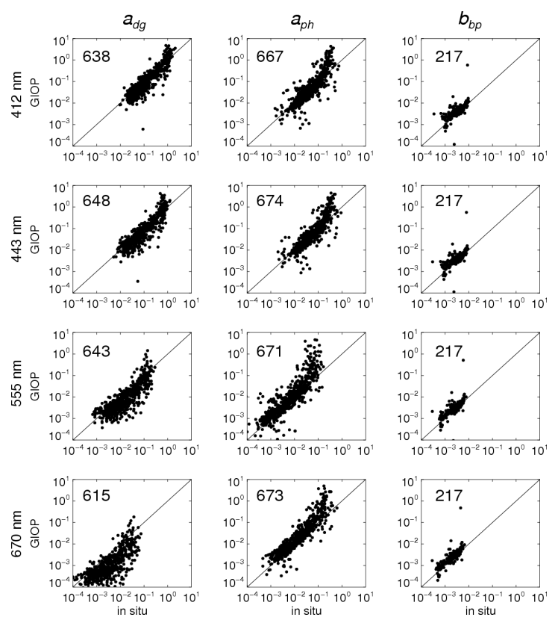
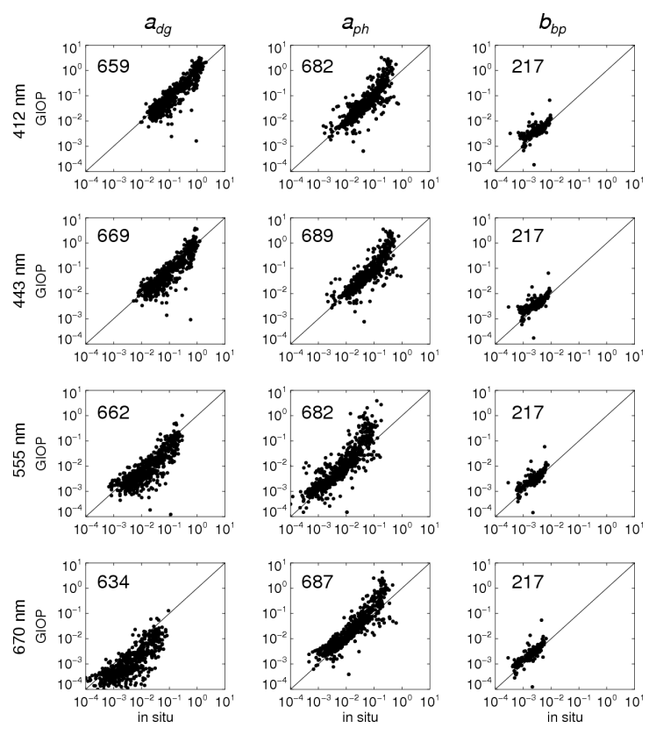
match-ups: http://oceancolor.gsfc.nasa.gov/cgi/giopval.cgi
baseline (Morel f/Q) vs. Gordon quadratic
baseline (Morel f/Q) Gordon quadratic

Slide 34
INSERT:
http://oceancolor.gsfc.nasa.gov/ANALYSIS/global/sgiop05_sgiop02/giop_g88_morel_zonal.html

Slide 35
match-ups: http://oceancolor.gsfc.nasa.gov/cgi/giopval.cgi
baseline (Morel f/Q) vs. Gordon quadratic
insert regression statistics and Δs
insert comments
baseline (Morel f/Q) Gordon quadratic

Slide 36
Back-up

Slide 37
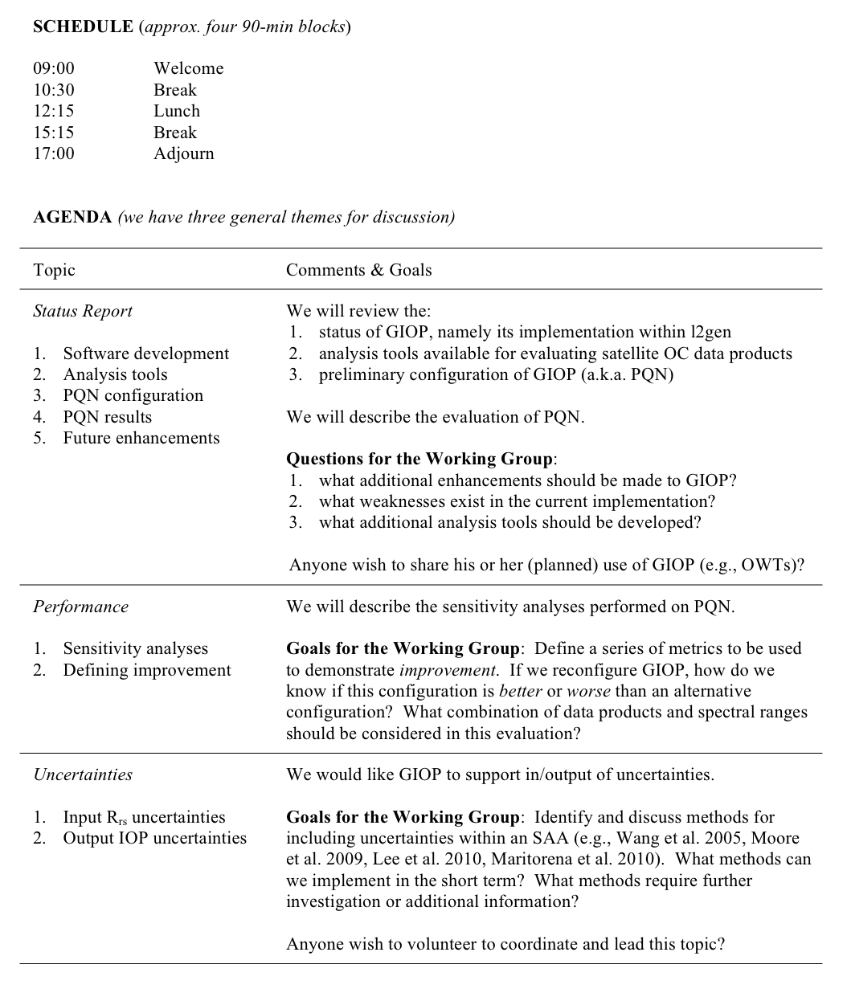

Slide 38
Sensor Calibration & IOP Trends

Slide 39
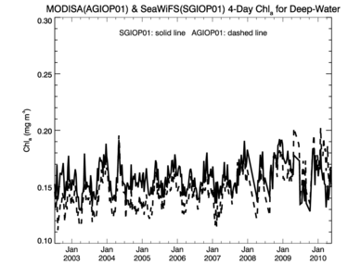
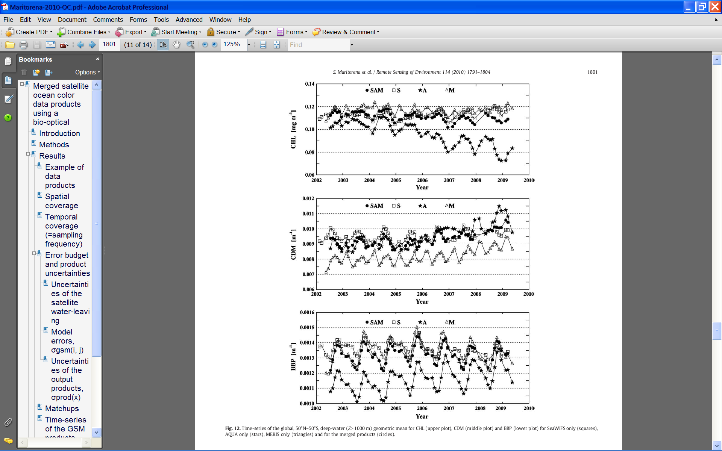
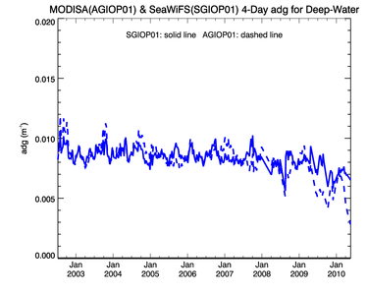
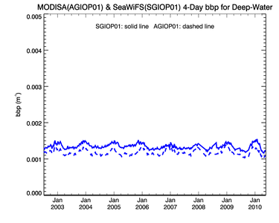
Maritotrena et al. 2010
GIOP Baseline – SeaWIFS & MODIS R2009.1

Slide 40
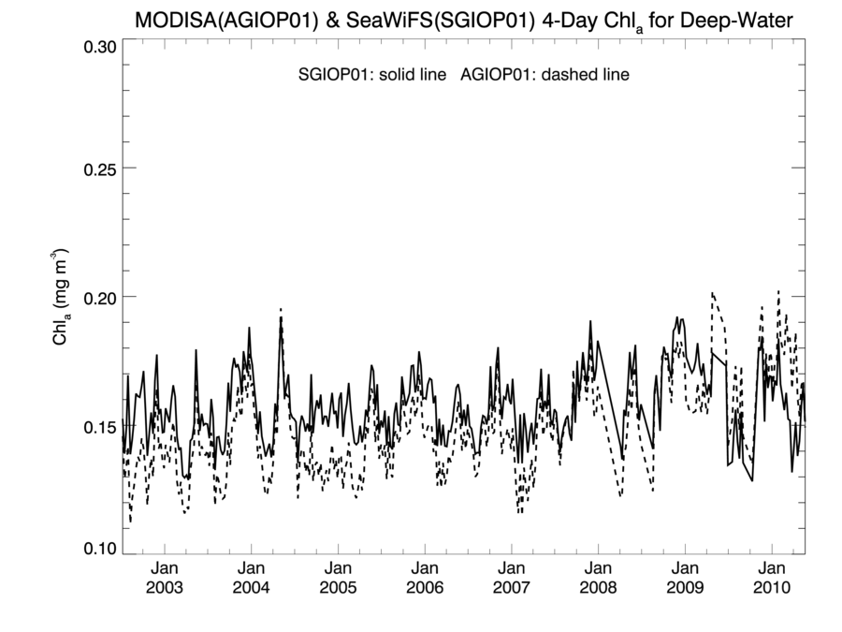

Slide 41
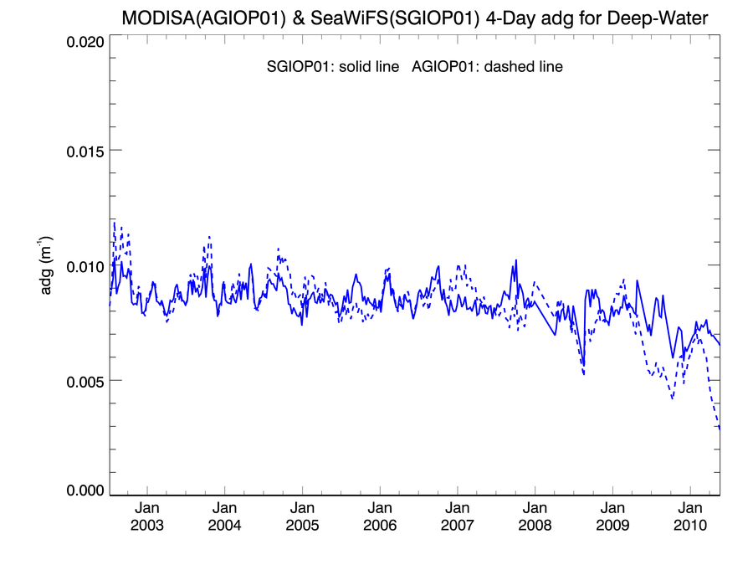

Slide 42
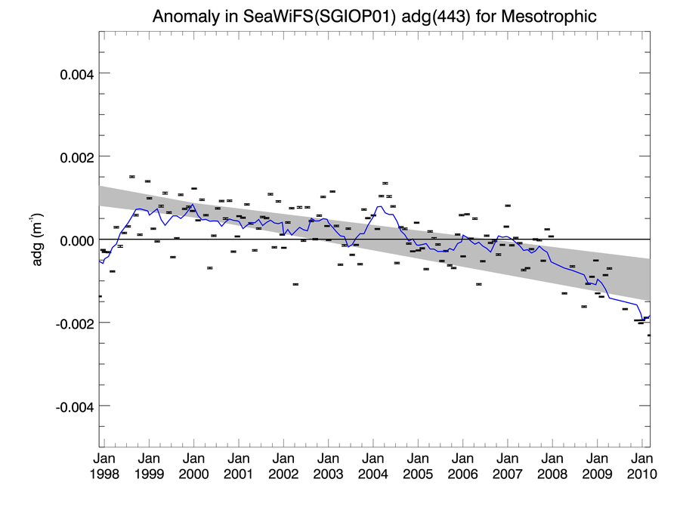
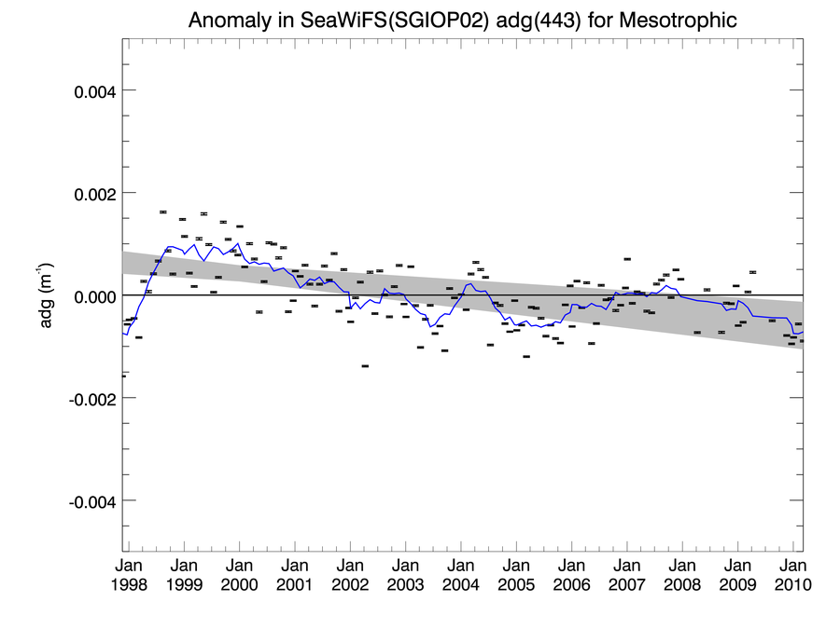
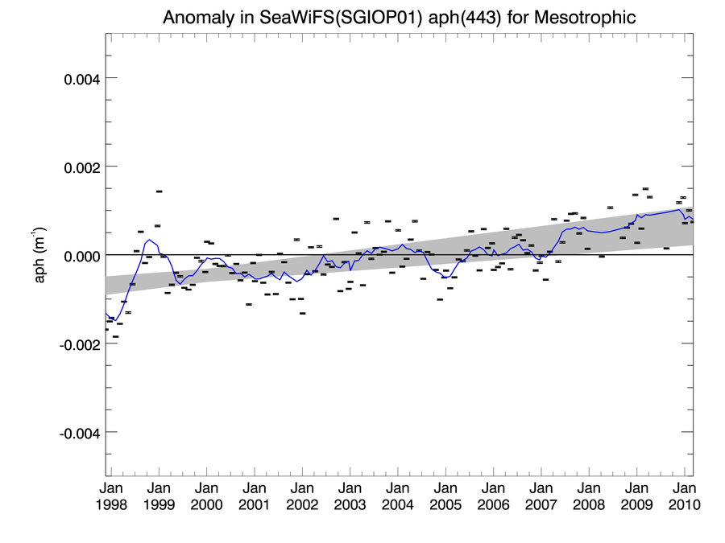
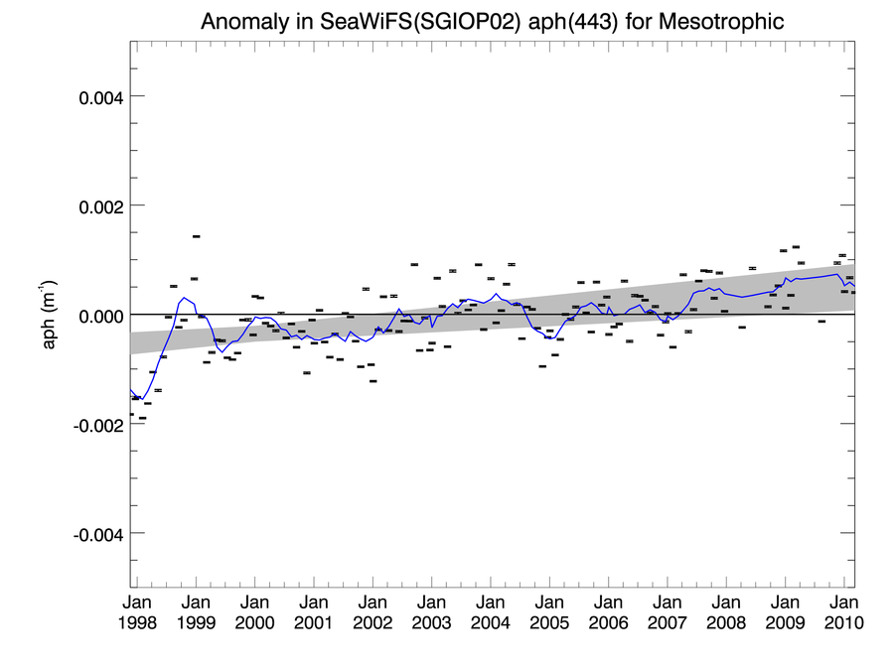
SeaWiFS Calibration Change – Impact to a_{dg} GIOP (PQN) Model

