Slide 1
Some (basic) considerations on our capability to derive b_{bp} from AOPs (R and K_{d}),
in situ and especially in clear waters
An example using data from
BOUSSOLE and Plumes & Blooms
(Mediterranean Sea and Santa Barbara Channel)
D. Antoine, LOV, Villefranche / mer

Slide 2
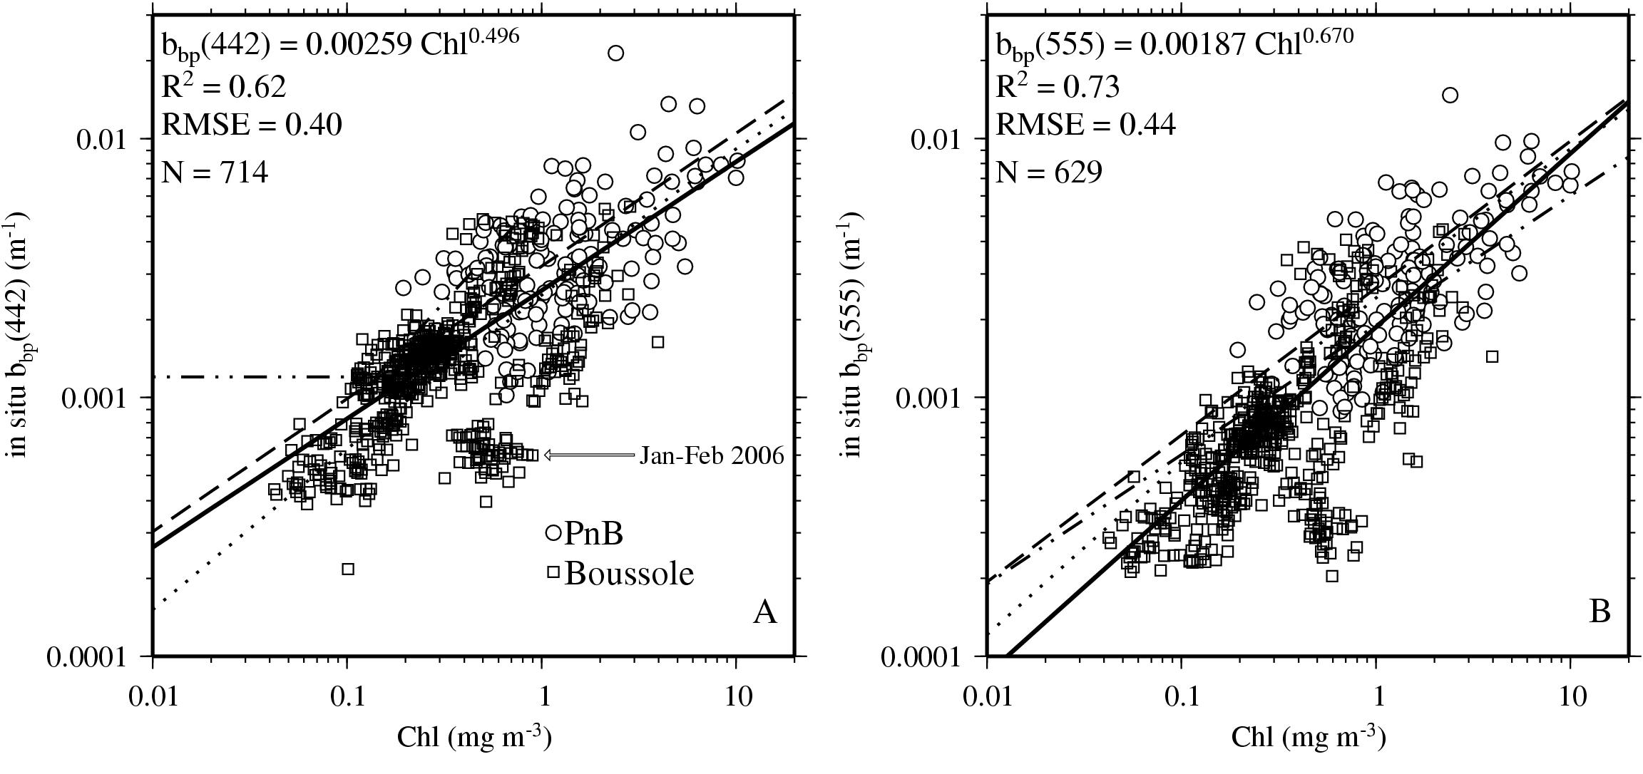
Relationships do exist between b_{bp} and Chl (quite scattered, however)
and
We have very few in situ b_{bp} measurements

Slide 3
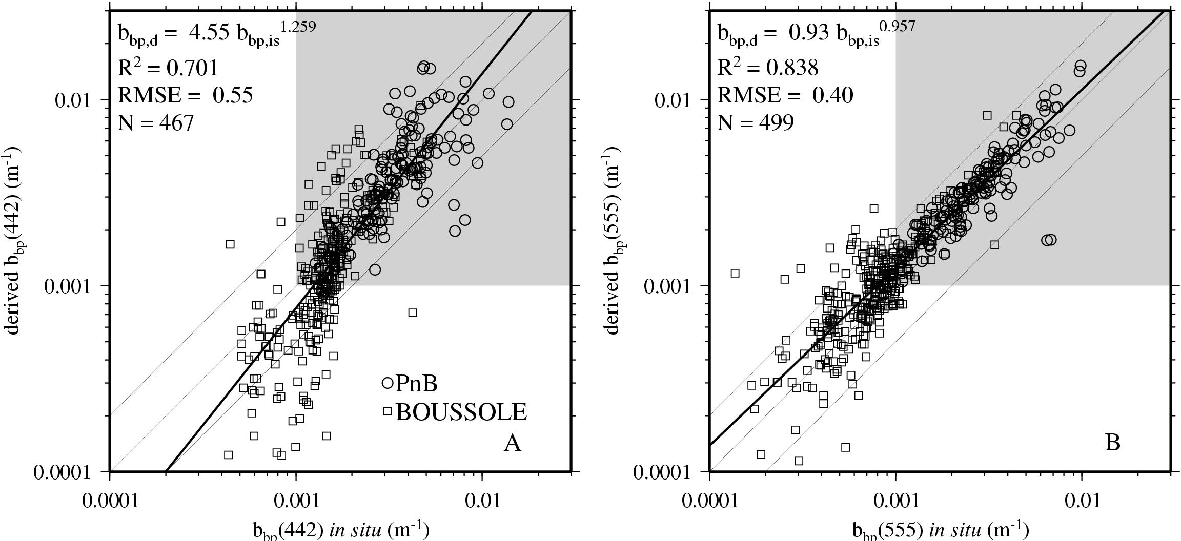
A simple inversion procedure using K_{d} and R as input (plus lookup tables of f’ and μ_{d} from RT computations) allows b_{bp} to be retrieved quite well
Morel, A., Gentili, B., Chami, M., and J. Ras (2006) Bio-optical properties of high chlorophyll Case 1 waters, and of yellow-substance- dominated Case 2 waters. Deep-Sea Research I, 53, 1439-1559
There are still issues for validation in the range of low b_{bp} (<~0.001 m⁻¹), which corresponds to Chl ~0.3 mg m⁻³, i.e., ~50% of the ocean

Slide 4
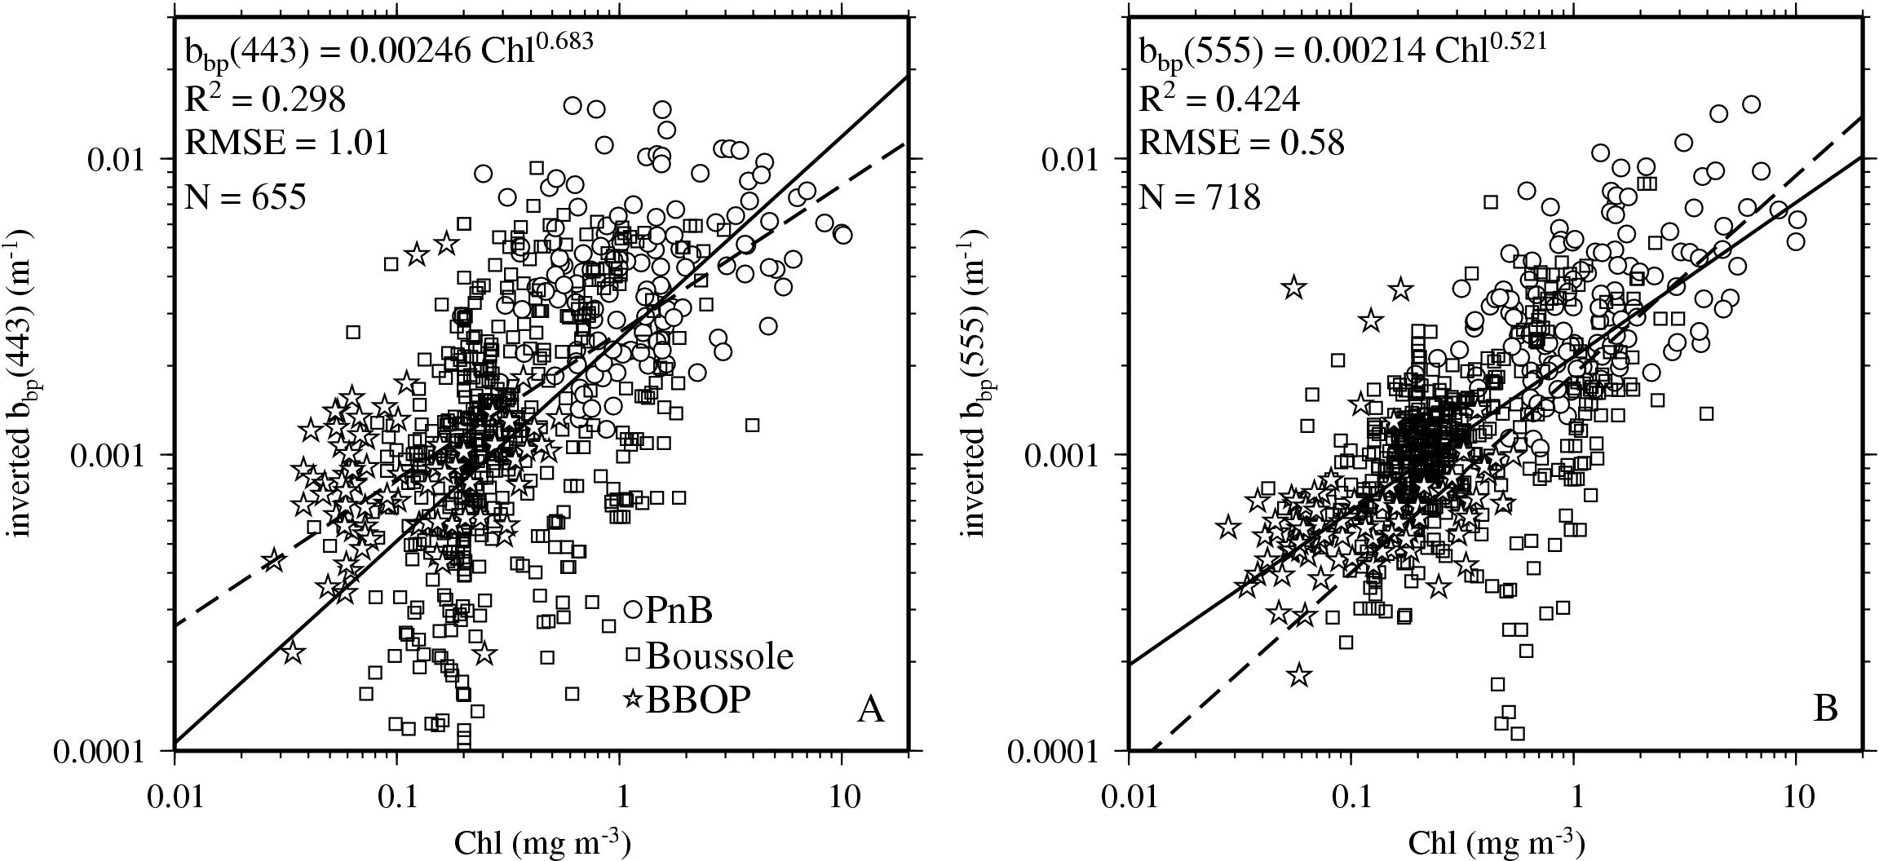
What does this mean, however, when coming back to the
b_{bp} vs Chl relationship?
The relationship is different, and differently at both wavelengths
→ problem for the spectral dependency..

Slide 5
We clearly need more data in the low-Chl domain (say below ~0.3 mg m⁻³)
- ~half of the IOCCG dataset is for bbp>0.01 m⁻¹, i.e., for Chl>5 mg m-3
- Much better for the NOMAD data set
- Values < 0.001 m⁻¹ are underrepresented into both data sets, however (see Jeremy and Bryan slides N°13 and 14)
We still need an overall error assessment, using simultaneous in-situ and satellite-derived b_{bp}, R and K_{d}
(the satellite configuration is necessarily degraded because both R and K_{d} are derived from nLw’s).

Slide 6
That’s all…
see poster #63, session #3
Variability in optical particle backscattering
in three contrasting bio-optical oceanic regimes
David ANTOINE, David A. SIEGEL, Tihomir KOSTADINOV, Stéphane MARITORENA, Norm B. NELSON, Bernard GENTILI, Vincenzo VELLUCCI, Nathalie GUILLOCHEAU

Slide 7
IOPs from K_{d}-R inversion
Morel, A., Gentili, B., Chami, M., and J. Ras (2006) Bio-optical properties of high chlorophyll Case 1 waters, and of yellow-substance- dominated Case 2 waters. Deep-Sea Research I, 53, 1439-1559
K_{d}(λ) = 1.0395 [a(λ) + b_{b}(λ)] / μ_{d} (Gordon, 1989)
R(λ) = f' b_{b}(λ) / [a(λ) + b_{b}(λ)]
a(λ) = 0.962 K_{d}(λ) μ_{d}(λ, θ_{s}, Chl) x [1 – R(λ) / f'(λ, θ_{s}, Chl)]
b_{b}(λ) = 0.962 K_{d}(λ) μ_{d}(λ, θ_{s}, Chl) x [R(λ) / f'(λ, θ_{s}, Chl)]
LUTs are used for μ_{d} and f’ (Morel & Gentili, 2004)
Then : b_{b,p}(λ) = b_{b}(λ) – b_{bw}(λ)
b_{bw}(λ) computed followingTwardowski et al (2008), as a function of T and S

