Slide 1
EOSDIS Tools & Services Portfolio
John Kusterer, ASDC DAAC
Justin Rice, ESDIS

Slide 2
Original Objectives
To evaluate and update the existing inventory DAAC and EOSDIS tools and services to understand the current portfolio
To identify tools and services with apparent overlapping functionality and evaluate to determine what, if any, efficiencies may be gained moving forward
To create a framework for a governance process to apply to future tool and service development efforts

Slide 3
The Effort
Chris Doescher (LPDAAC) & John Kusterer (ASDC DAAC) led
  Supported by Lindsay Harriman, Scott Saxon
Between Chris and John, visited all DAACs
  Went over effort, purpose, addressed questions and concerns
  Trying to cultivate environment of trust to facilitate collaboration
What was different from past efforts?
  DAACs OWN and MAINTAIN their inventory
    No liberties taken to change DAACs information in the inventory
  Developed and rolled out collaboration process for ESDIS/inter-DAAC communication and collaboration
    Collaborations in the past (e.g., APPEARS) have had a sense of “randomness” to them

Slide 4
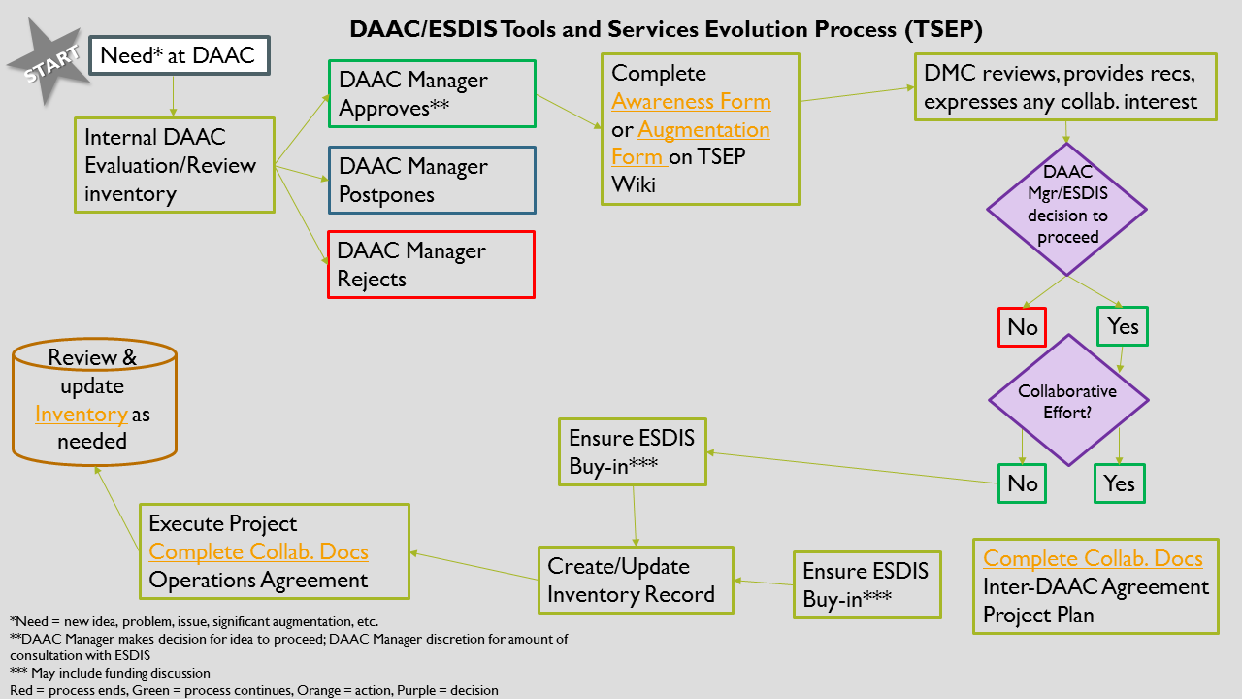
The Process (TSEP)

Slide 5
Features of the TSEP
Communication is promoted across DAACs and ESDIS
  Awareness for those DAACs who choose not to participate
  ESDIS sponsor required for the effort to ensure Project alignment
Participation among DAACs is voluntary
  DAACs know their own needs the best
  DAACs can’t do everything
Aimed to address “what happens when we roll it out?” question
  Operational agreement identifying who does what
  Clear roles and responsibilities

Slide 6
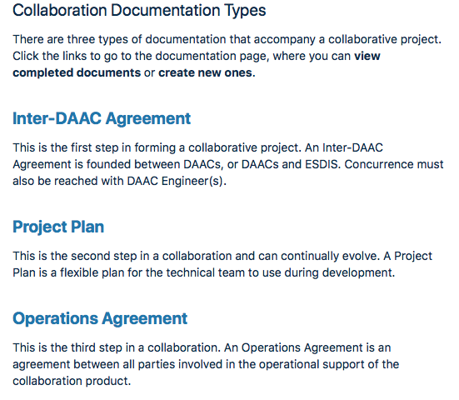
TSEP Roll-out
ESDIS Forum initial pathfinder
  5 DAACs volunteered for participation
  Developed and reviewed documentation
  Cadence slowed by technical challenges
  Should be rolled-out this Summer
Documentation can be found on website
  Hyperlinks to each document
  Currently in draft form

Slide 7
TSEP Roll-out
Reality…
  Methods of communication have to be clearer
    A number of potential collaborations have not gained traction
  A fair amount of tailoring may be in order
    Services, efforts that a prime for collaboration but are not really applications
  Want to remain focused on objectives
Haven’t done analysis of inventory to look for opportunities
  Just need to focus some efforts on analysis (competing priorities)
  Always need to be careful about taking liberties in analysis
    DAAC retain final call on what a tool is as far as categorization, roll-up

Slide 8
TSEP Path Forward
Finish up the ESDIS Forum to have a success
Process
  Tailor the process to suit objectives (who owns this?)
Inventory
  Examine inventory to look for opportunities
    Efficiencies to be gained?
  Better understand technology profile across DAACs

Slide 9
Discussion
Moderator: John K.

Slide 10
Reality (picking up from slide 6)…
A number of potential collaborations have not gained traction.
To gain better insight on what generally happens with cross-DAAC collaborations, let us turn our attention to a specific use case ....

Slide 11
Earthdata Pub Goals
Goal #1 (information subgroup): Help foster more consistent communication between DAACs and data producers across EOSDIS. Includes:
  identifying synonyms and standardizing common terminology
  evaluating data publication processes at DAACs
  developing resources for data producers about data publication
Goal #2 (technical development subgroup): Build a data publication framework that:
  provides a consistent cross-DAAC experience for data providers
  helps DAACs to streamline internal processes
  reduces the time required to publish data products

Slide 12
Earthdata Pub Timeline
CDPF presented at SE TIM: August 30, 2017
Justin assigned as ESDIS POC to CDPF: September 29, 2017
Earthdata Pub F2F: March 26, 2018
DevTeam subgroup kickoff meeting: April 11, 2018
Collected use cases from DAACs: May - July 2018
Investigated other workflow management solutions: May - July 2018
Developed initial architecture diagram: July 2018
Received DAPPeR 2.0 proposal: June 29, 2018
Telecon with GHRC to discuss DAPPeR 2.0/Earthdata Pub synergy: August 13, 2018
Earthdata Pub presentation @ SE TIM: August 29, 2018
Received revised DAPPeR 2.0 proposal: August 29, 2018
Earthdata Pub working meeting @ SE TIM: August 30, 2018
Developed 20 page joint project plan: September 2018

Slide 13
Original Architecture Philosophy
Earthdata Pub Framework is:
  Platform agnostic - DAACs determine where it lives
    Cloud
    On-Premise
    Hybrid – in cloud and on-premise
  Modular - DAACs determine which modules they adopt
    DAACs could:
      adopt all modules if they had no existing data publication tool
      adopt some modules to work with existing data publication tool

Slide 14
Earthdata Pub Timeline
Submitted DMC awareness form: September 24, 2018
Submitted project plan: October 17, 2018
Completed Earthdata Pub proposal: February 1, 2018
Conducted Earthdata Pub proposal walkthrough with ESDIS: February 8, 2019
Earthdata Pub tag-up with Andy: February 15, 2019
  Response: Need more DAACs to commit
    Tag-up with Doescher: March 4, 2019
    Tag-up with Suresh: March 7, 2019
Earthdata Pub monthly telecon (dockerized DPS proposed): April 2, 2019
Earthdata Pub Tag-up with Andy: April 8, 2019
  ESDIS response and recommendation
Earthdata Pub monthly telecon: May 5, 2019

Slide 15
ESDIS recent response and recommendation
Response:
  “Clone and own” philosophy will:
    cause DAAC implementations to drift too far from baseline
    ultimately create the very problem this effort is attempting to solve
Recommendation
  Have one front-end implementation that lives in the cloud
  DAACs are free to choose where their respective back-end implementations live
  DAAC specifications need to be submitted, reviewed, and approved regardless as to whether DAACs:
    operate on-premise
    have an existing data publication tool

Slide 16
DAAC concerns
No clear way to fund, manage, and prioritize cross-DAAC development activities that exist outside of EED2 and SAFe*
  *could possibly be resolved with TSEP process
Cross-DAAC efforts move too slow
  This effort is no closer to moving forward with development than it was when the team first submitted the project plan in 2018
  There is little confidence that the team will be able to receive funding, start development, and have a tool ready within an acceptable timeframe
Certain DAACs already have a data publication tool
  Development required a lot of time, energy, and effort
  SAuS, DAPPeR, CAMP, DPS

Slide 17
ESDIS concerns
“Clone and own” philosophy
ROI (return on investment)
  Which DAACs will actually adopt and use Earthdata Pub?
    We need at least X number of DAACs to commit to adopting and using Earthdata Pub BEFORE we invest

Slide 18
... from the Machine
Sometimes, there are project management decisions that seemingly occur unexpectedly that have a huge impact on team morale and momentum
  Deus Ex Machina (God from the machine)
    Positive momentum
  Diaboli Ex Machina (Satan from the machine)
    Negative momentum

Slide 19
Discussion on the Path Forward
Moderator: Justin R.

Slide 20
Backup Slides

Slide 21
Earthdata Pub FAQs
How is this Earthdata Pub different from Earthdata Drive?
Earthdata Pub is more of a grass-roots movement. Several DAACs have already explored alternate data publication tools and have independently decided to adopt SAuS or something SAuS-like.
What is the funding expectation?
Additional funds needed to develop enterprise solution
No additional funds needed for DAACs to get Earthdata Pub up and running at respective DAACs

Slide 22
Earthdata Pub FAQs
Is there overlap between Earthdata Pub and Data Product Developers’ Guide (DPDG)?
No. These efforts are complementary.
  Earthdata Pub aims to improve:
    consistency in web interface and communication with data producers
    internal coordination with data management team
    time need to publish datasets
  DPDG aims to improve:
    data usability for end users

Slide 23
Earthdata Pub FAQs
Which DAACs are actively involved in Earthdata Pub?
ASDC
GES DIS
GHRC
NSIDC
LP DAAC
ORNL
PO.DAAC

