Slide 1
EOSDIS FY2022
Annual Metrics Report
Prepared By:
Lalit Wanchoo, Adnet Systems, Inc.
Dany Turcios, Adnet Systems, Inc.
Yan Hao, Adnet Systems, Inc.
December 2022

Slide 2
Preface
The Earth Sciences Data and Information System (ESDIS) Project (Code 423) prepared the following report on metrics from across the Earth Observation System Data and Information System (EOSDIS). The 12 Distributed Active Archive Centers (DAACs) of EOSDIS support different scientific disciplines and provide an individualized set of products and services to their science community and the public. Although discipline oriented, the DAACs engage in common data management functions of ingest, archive and distribution, as well as describing their data and services on web sites. Metrics are collected on a daily basis from each DAAC. The ESDIS Project collects these metrics in a tool called the ESDIS Metrics System (EMS). DAAC analysts can view their detailed metrics to assess internal performance and trends. The ESDIS Project combines these metrics, not for comparisons between the DAACs, but as a system level view of EOSDIS performance. This report provides snapshots of metrics as the combination of the individual DAACs and as a system. In keeping with previous years, and in order to support trend comparisons, the metrics data are presented on a fiscal year basis, not by calendar year. These reports are posted online with metrics as far back as 1996. Each report includes some historical trend information. If you have any questions or comments, please contact Drew Kittel (301) 614-6582 or drew.h.kittel@nasa.gov..

Slide 3
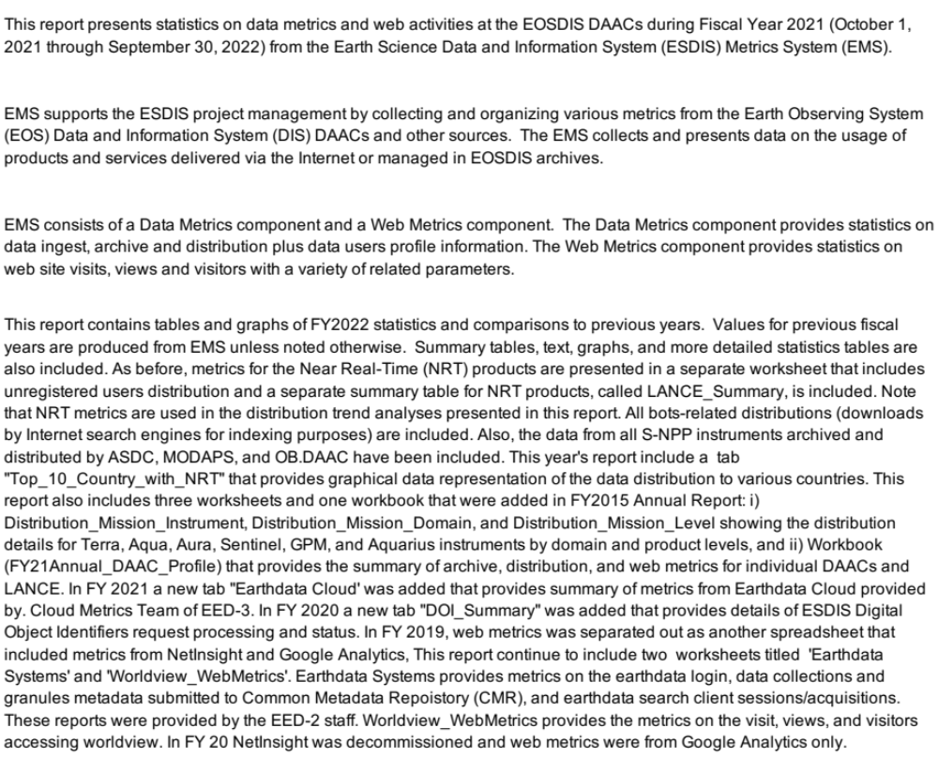
Introduction

Slide 4
Report Structure
Three Excel Spreadsheets
  1) Data Ingest, Archive, and Distribution with long-term trends
  2) Web access metrics
  3) Individual DAAC Profiles
One Powerpoint

Slide 5
Key Points
Includes Earthdata Cloud Archive and Distribution data that have been provided to the EMS
Archive and Distribution Summary provided by the Cloud Metrics Team (EED-3) is provided as a separate metrics
Some of the DAACs who have moved data to cloud prior to providing data to the EMS, have not backfilled the data.
Archive data was verified by DAACs and some DAACs provided updated data
EMS has data from the following DAACs that have migrated to Earthdata Cloud:
  ASF, GESDISC, GHRC, LPDAAC, NSIDC, ORNL, and PO.DAAC

Slide 6
Contents
EOSDIS Summary
LANCE Summary
Data Metrics (Distribution and Users)
LANCE Metrics
Earthdata Cloud Metrics (Cloud Team)
DOI Summary
Web Metrics
Worldview Web Metrics
Total Users and Multi-year Trends
Earthdata Systems (Earthdata Login, CMR, and EDSC)
DAAC Profiles
Daily Data Availability
Definitions

Slide 7
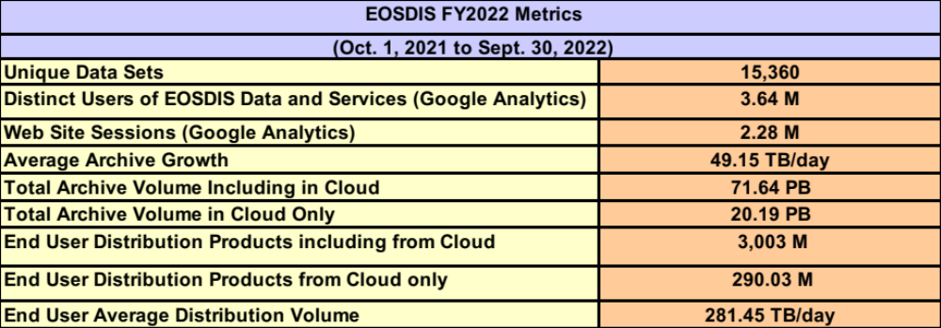
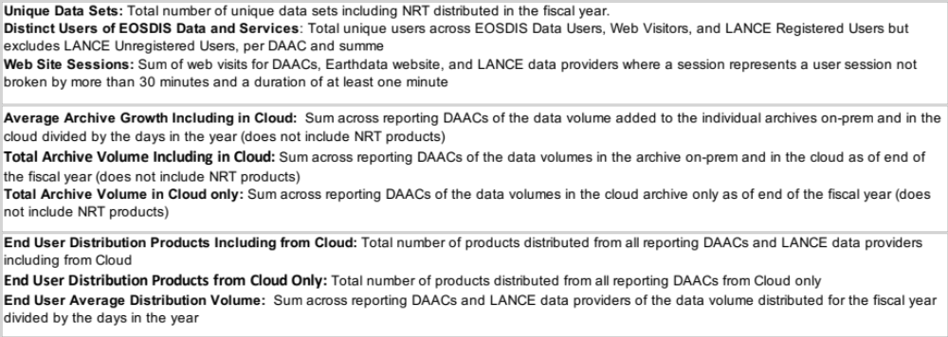
EOSDIS Summary

Slide 8
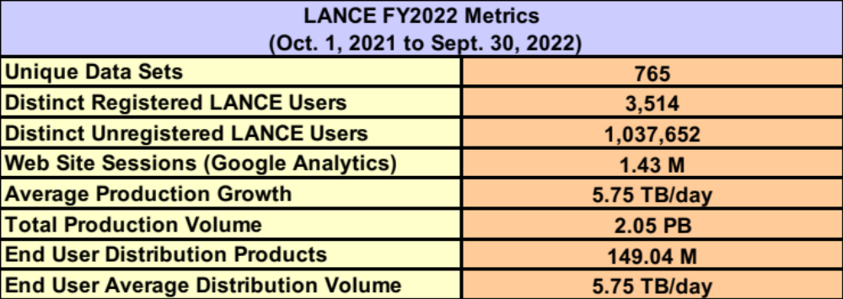
Land Atmosphere Near real-time Capability for EOS (LANCE) Summary
Unique Data Sets: Total number of unique data sets distributed in the fiscal year
Distinct Registered LANCE Users: Total number of unique LANCE users who registered and retrieved NRT products from all LANCE data providers, excluding the unregistered users who downloaded imagery products from the MODIS Rapid Response System
Distinct Unregistered LANCE Users: Total number of unique IP Addresses/Emails that retrieved browse imagery products from LANCE data providers, such as Rapid Response Browse Images and excludes the LANCE registered users.
Web Site Sessions: Sum of web sessions for LANCE data providers where a session represents a user session not broken by more than 30 minutes and a duration of at least one minute
Average Production Growth: Sum of the NRT data volume generated by all LANCE providers divided by the days in the year, including the NRT and NRT2 processing streams
Total Production Volume: One year of production volume of the NRT/NRT2 data products.
End User Distribution Products: Total number of products distributed from all reporting LANCE data providers
End User Average Distribution Volume: Sum across reporting LANCE data providers of the data volume distributed for the fiscal year divided by the days in the year

Slide 9
Data Metrics
Ingest
Archive
Total Archive
Distribution
- By DAAC
  - By Mission/Instrument
  - Volume by Domain
  - Products by Domain
  - Products by Product Level
  - Top 20 Countries
  - Unique Product Count
  - Top 10 Products
Data Users
- Distinct Users
- Repeat Users
- Top 20 Countries
- Foreign Users
Distribution
    LANCE (Near Real-time)
    - Products Production
    - Distribution
    Earthdata Cloud Metrics
    Digital Object Identifiers
    - Summary

Slide 10
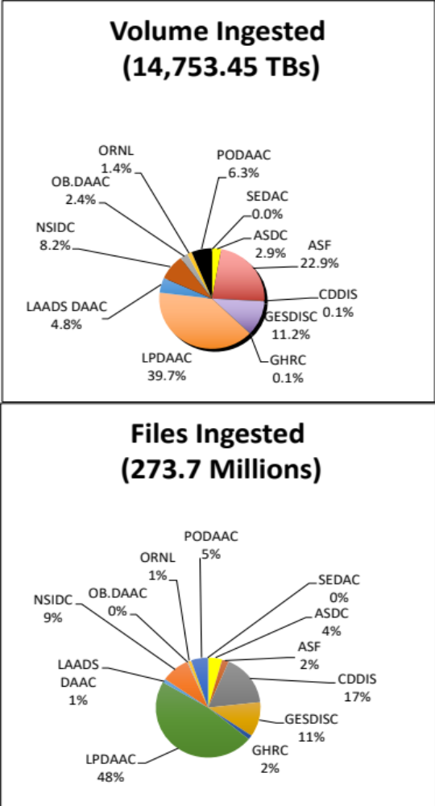
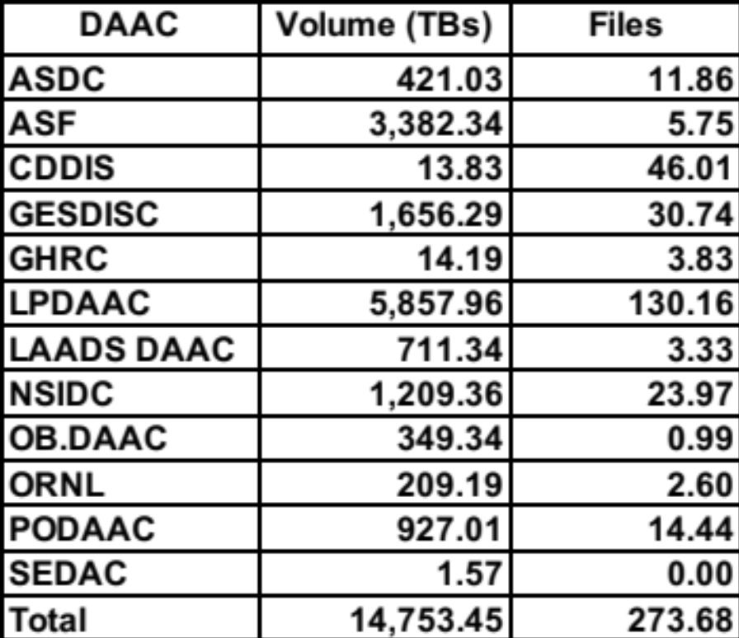
Ingest
Ingest is the amount of data coming into a DAAC over a period of time and includes all product levels. For this report, the data is presented as the amount of data entered into each DAAC during FY2022 and excludes NRT data. The sum over all data centers is the total ingest for EOSDIS.

Slide 11
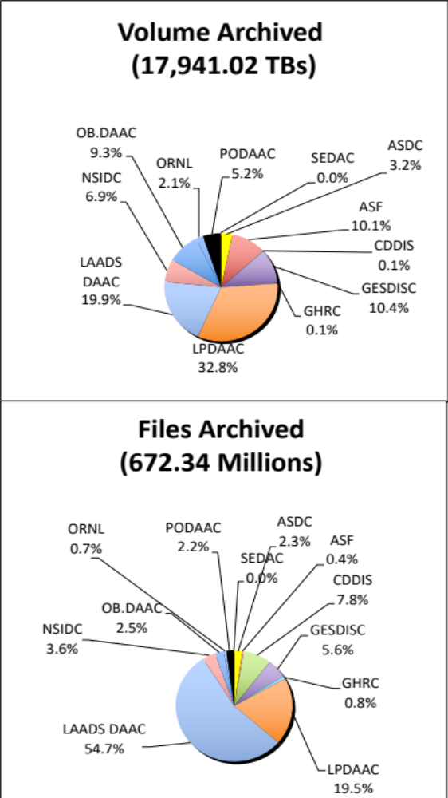
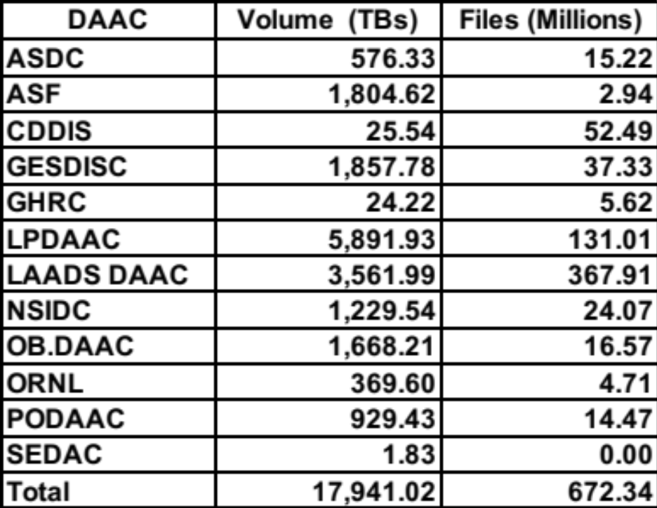
Archive
This table shows the amount of data added to the archive during FY2022 and includes all products levels. Archive metrics for NSIDC V0 are not available at this time. NRT data are excluded in this table.

Slide 12
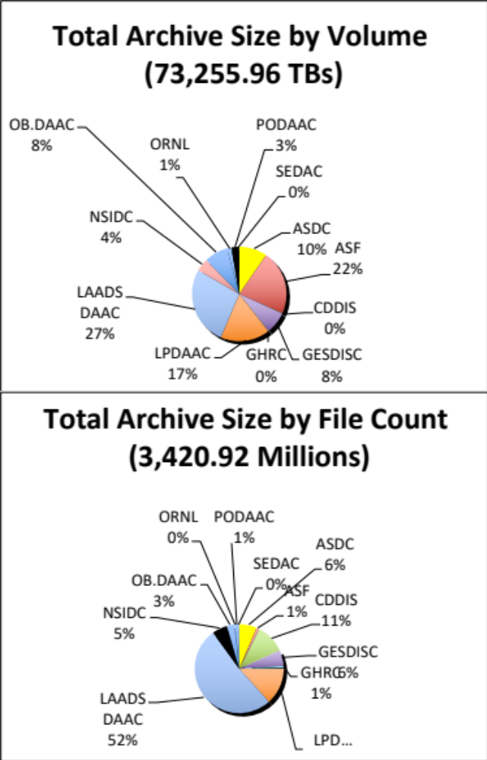
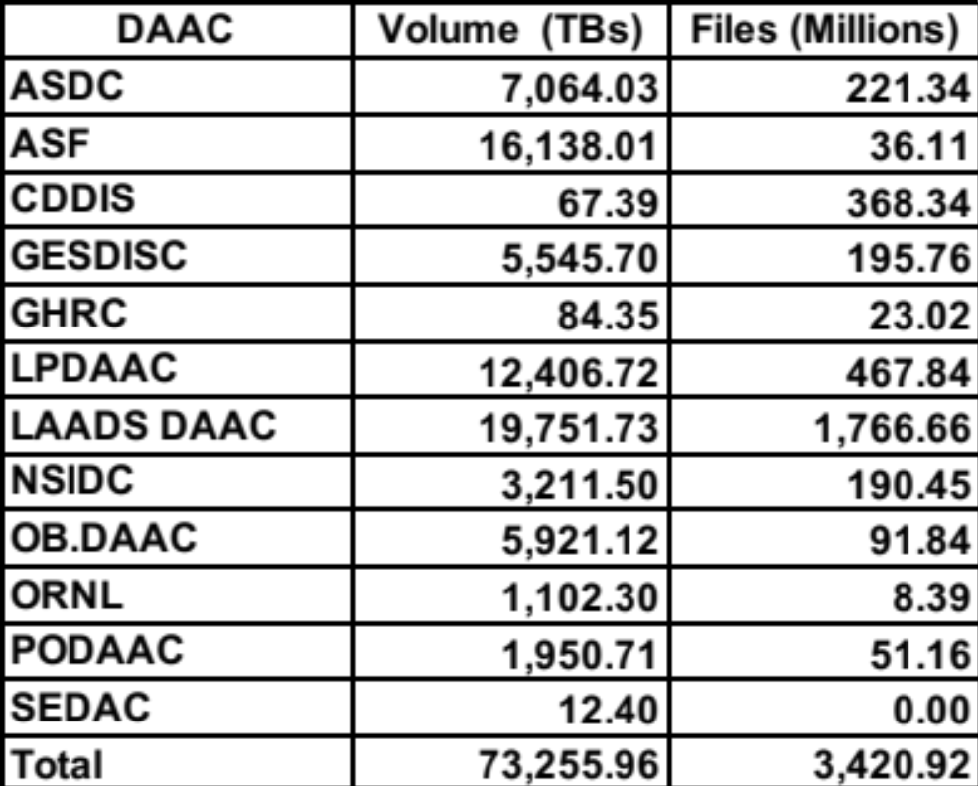
Total Archive Size
The Total Archive Size describes the EOSDIS archive at the end of FY2022. This includes all data (including ancillary) but not data marked for deletion and excludes NRT data.

Slide 13
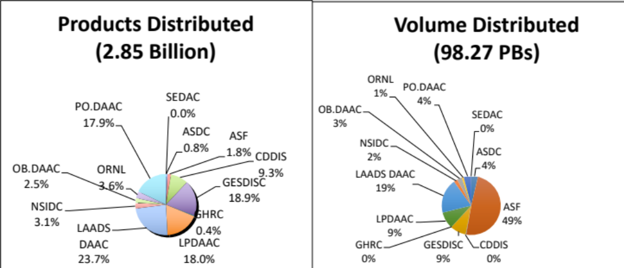
Distribution By DAAC
Distribution presents the amount of data successfully distributed to Public Users and excluded NRT data.

Slide 14
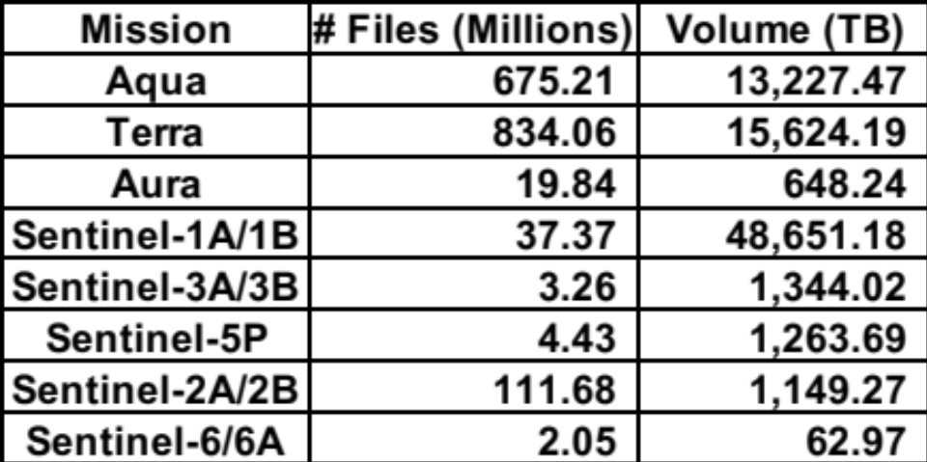
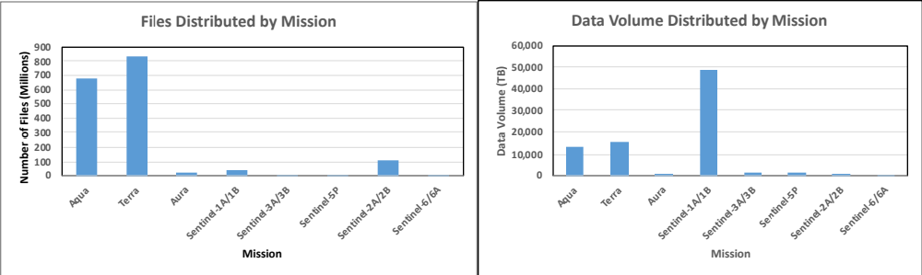
Distribution By Mission/Instrument
Distribution presents the amount of data successfully distributed to Public Users.

Slide 15
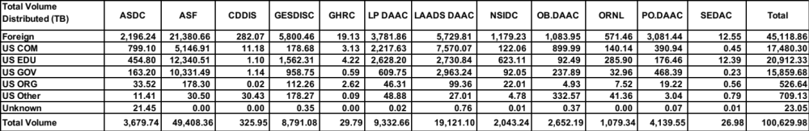
Volume Distributed By Domain
Volume Distribution presents the volume of data successfully distributed to Public Users by Domain.

Slide 16
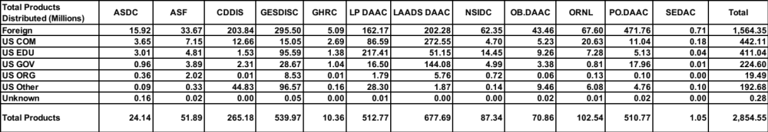
Product Distribution By Domain
Product Distribution presents the number of products successfully distributed to Public Users by Domain.

Slide 17
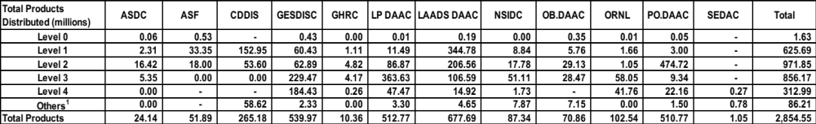
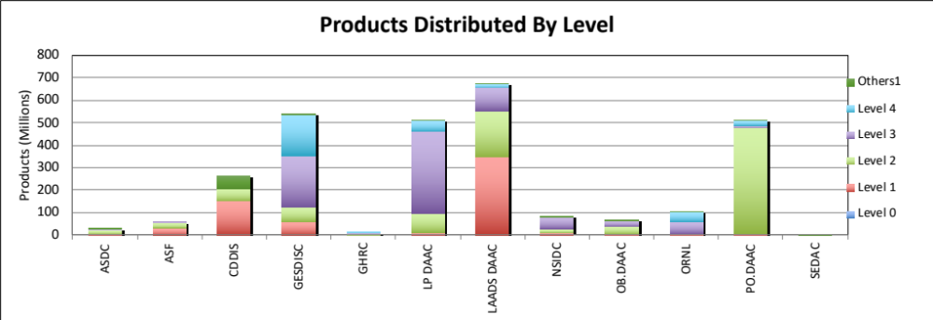
Distribution By Product Level
Distribution presents the amount of data successfully distributed to Public Users and excludes NRT products.

Slide 18
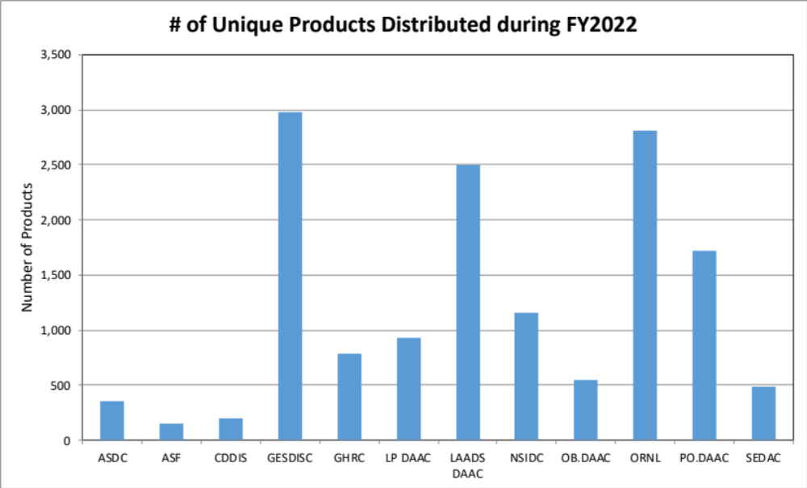
Distribution of Unique Data Products
Tables below show the number of unique data products distributed to public users during FY2022. In counting unique products, metadata were excluded. NRT products are not included.

Slide 19
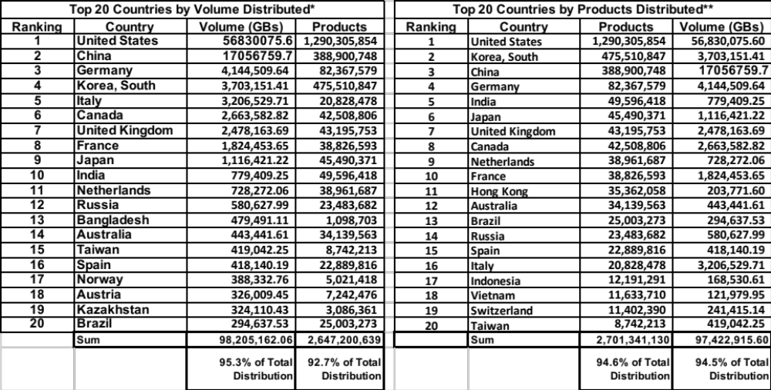
Data Distribution - Top 20 Countries
Affiliations of the users who downloaded data from foreign countries are not known.
* Some products are inherently larger than other files in size and therefore may skew the results.
** When counting # of products, metadata files are excluded.

Slide 20
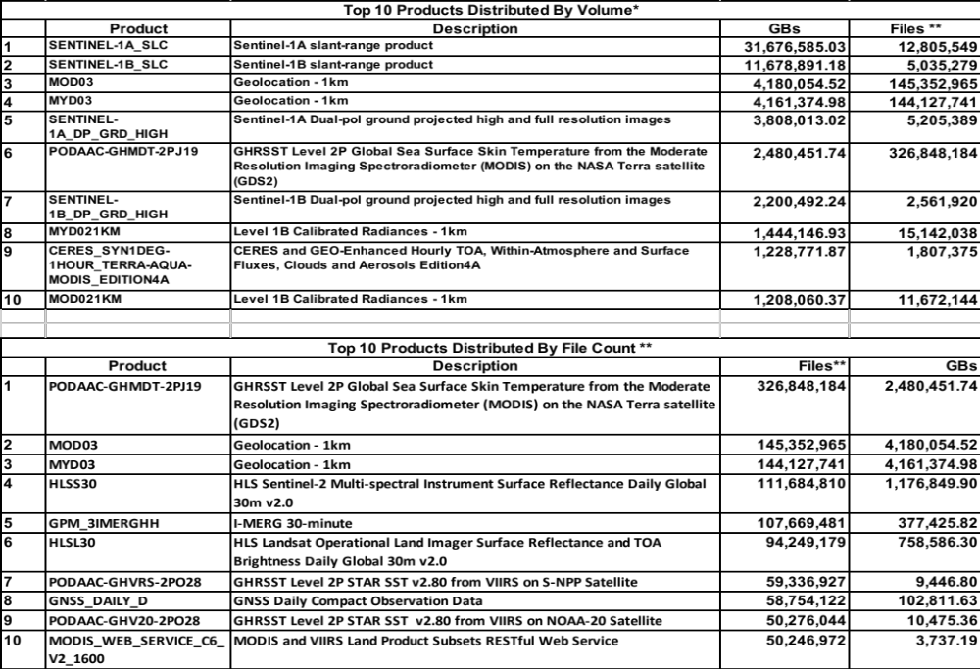
Data Distribution - Top 10 Products
* Some products are inherently larger than other files in size and therefore may skew the results.
** When counting # of files, metadata files are excluded.

Slide 21
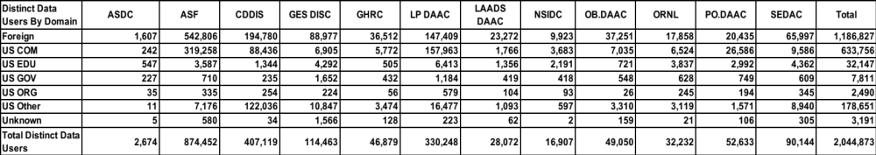
Distinct Data Users
Distinct Data Users presents the number of distinct public users who received data product files.

Slide 22
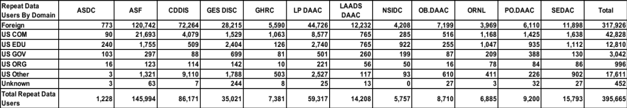
Repeat Data Users
Repeat users are distinct Public users who received data on more than one day in the fiscal year.

Slide 23
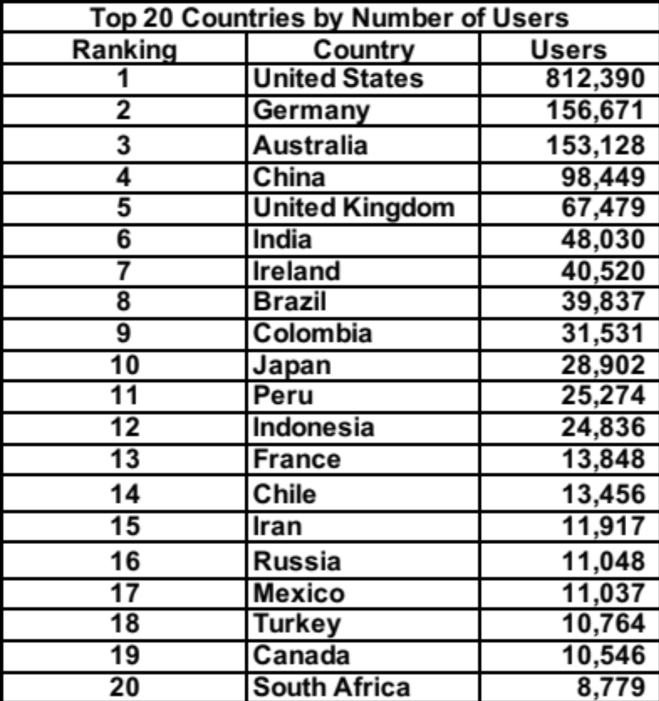
Data Users - Top 20 Countries

Slide 24
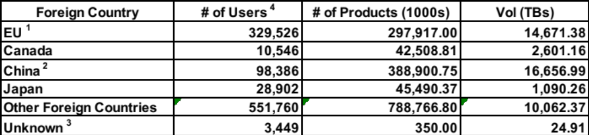
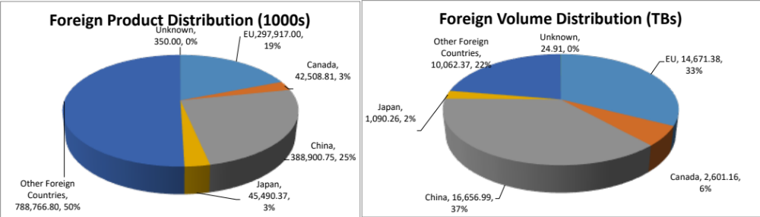
Foreign Distribution
Distribution metrics for foreign public users are compared. Statistics are based on country information provided by the 12 EOSDIS DAACs.
1. EU includes 27 European Union member countries, UK and territories under EU countries' and UK's sovereignty
2. China includes only People's Republic of China and does not include Hong Kong and Taiwan
3. This represents the data users whose countries are unknown
4. These represent the user counts across all DAACs and may be fewer than the sum of users from individual DAAC due to multi-DAAC users

Slide 25
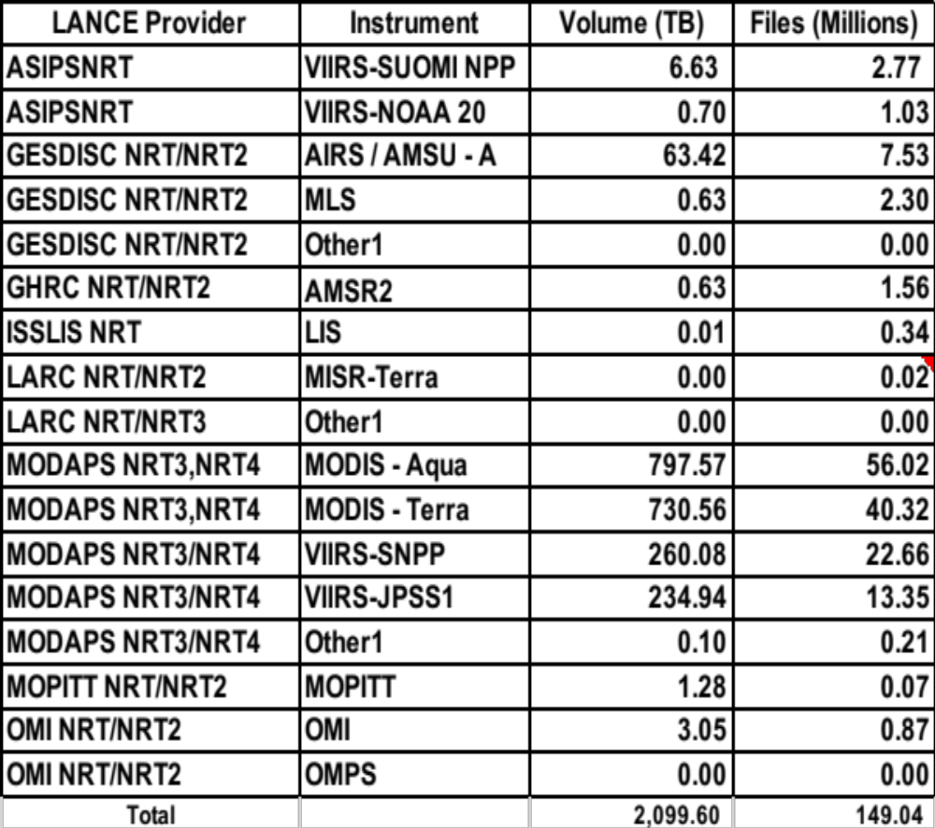
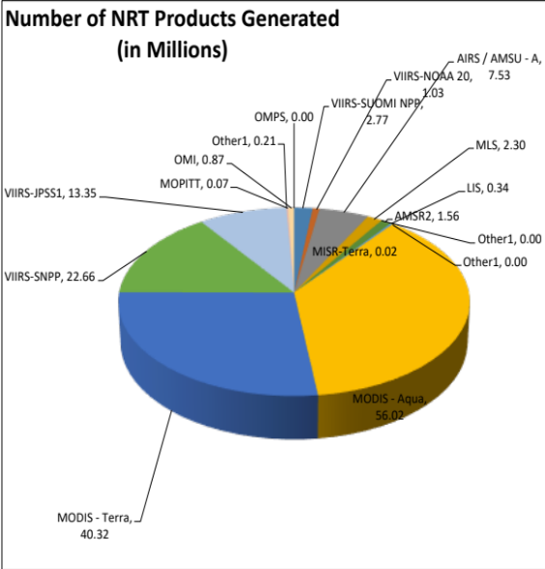
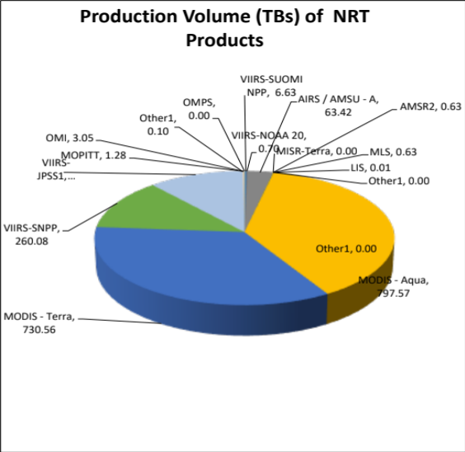
Production of Near Real-Time Products
Near Real-Time (NRT) production represents the amount of data generated by the Land Atmosphere Near Real-time Capability for EOS (LANCE) data providers, including the two identical processing systems, NRT and NRT2.
Volume and file count include the data products deleted from archive

Slide 26
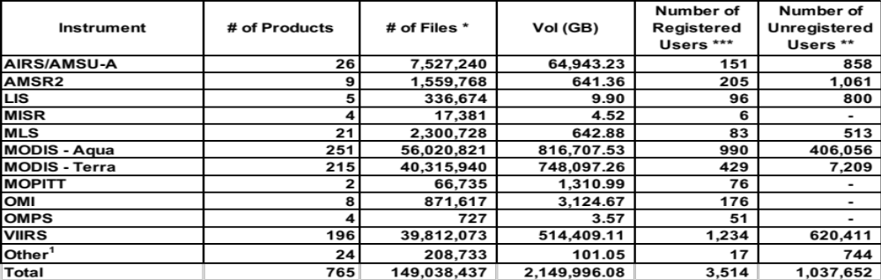
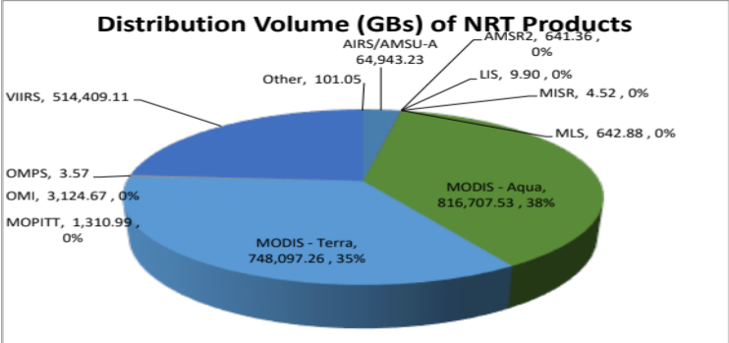
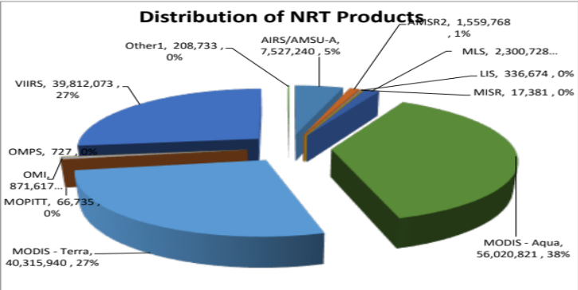
Distribution of Near Real-Time Products
Near Real-time (NRT) Distribution provides the amount of data successfully distributed to registered users of the Land Atmosphere Near Real-time Capability for EOS (LANCE). LANCE provides access to near real-time data (<3 hours from observation). Metrics for distribution volume, numbers of files distributed, and users are presented.
* Excludes metadata
** Represents the number of unique IP hosts/e-mail addresses used to retrieve NRT products, excluding registered users
*** Represents the number of the registered users who retrieved data for each instrument. It must be noted that sum of theses users
may be greater than the total number of unique registered users since one user could retrieve data for multiple instruments
1 These products do not have any mission or instrument mapping but have been distributed, such as ancillary data.

Slide 27
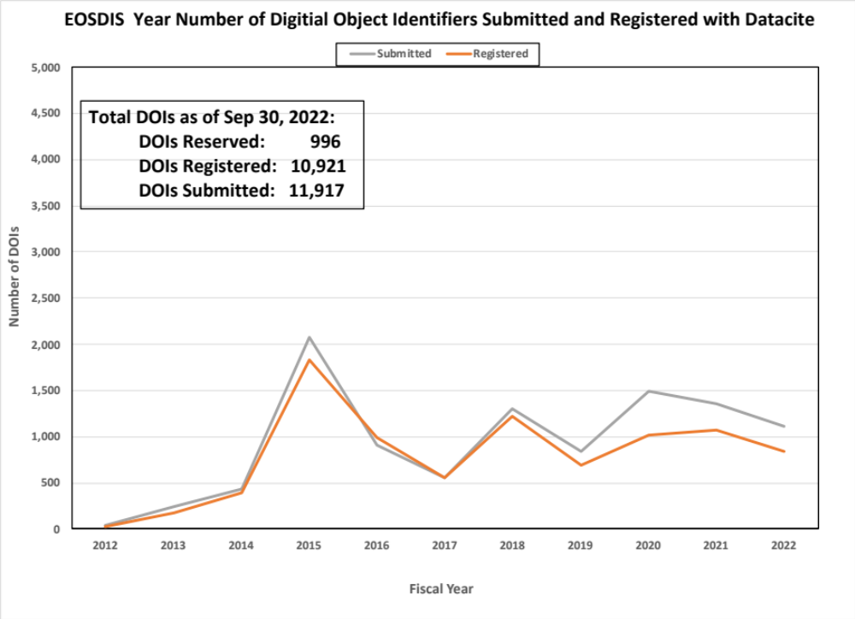
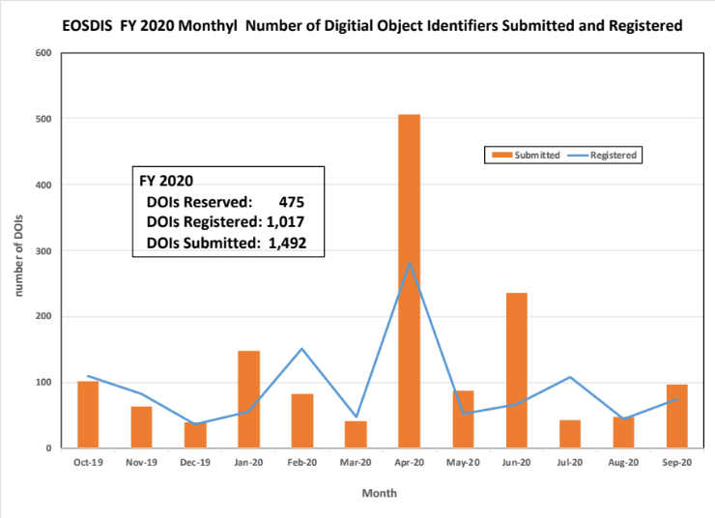
Digital Object Identifier Summary

Slide 28
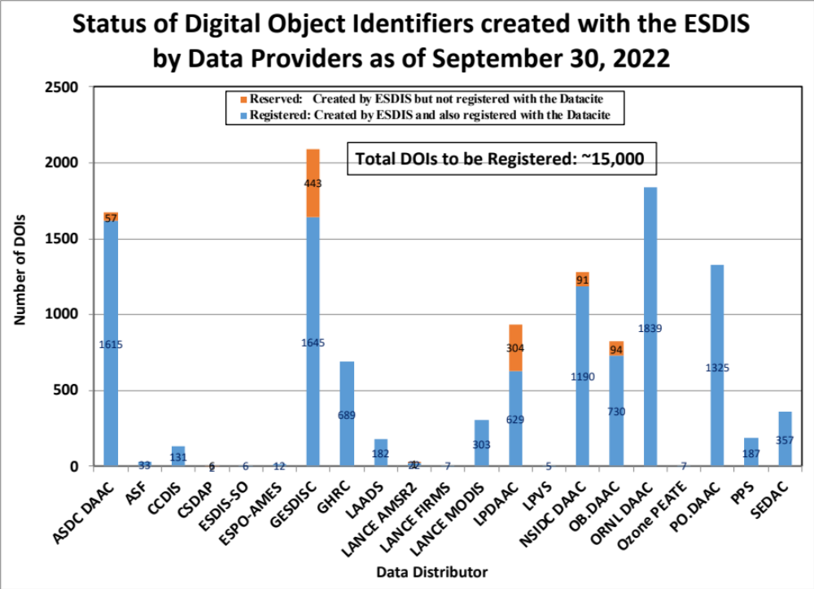
Digital Object Identifier Summary

Slide 29
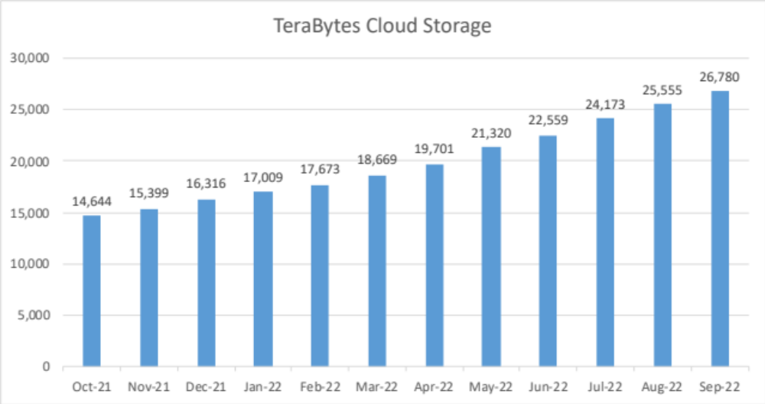
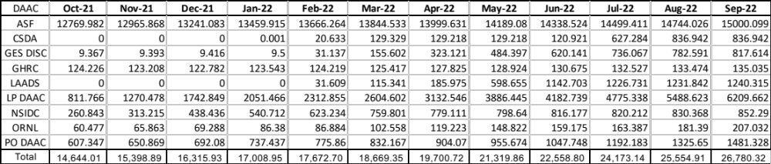
Earthdata Cloud Archive Metrics

Slide 30
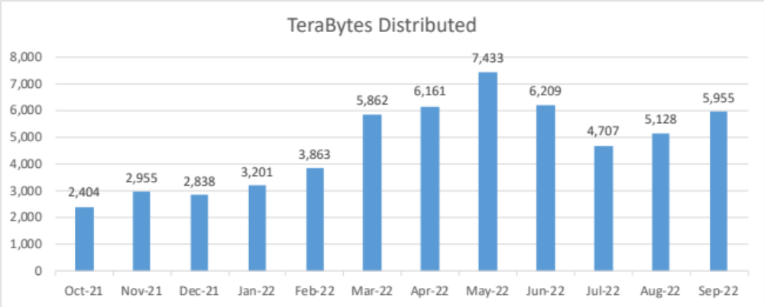
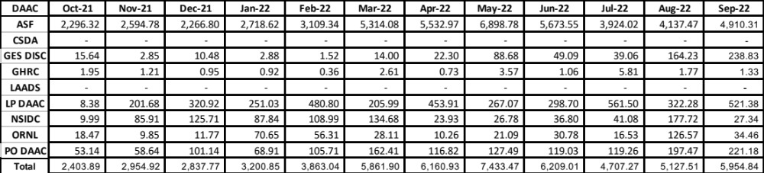
Earthdata Cloud Distribution Metrics

Slide 31
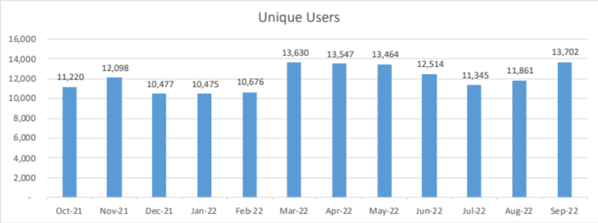
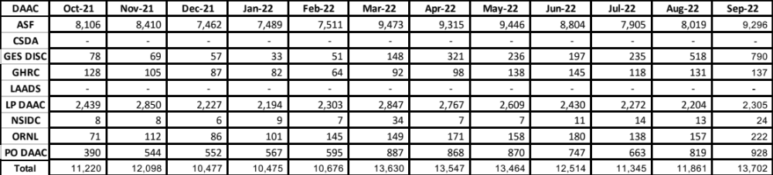
Earthdata Cloud User Metrics

Slide 32
Web Metrics
EOSDIS and Earthdata
  Visitors and Visits
  Repeat Visitors
  Top 20 Domains (NA)
    IPAddress not available
  Top 20 Countries
LANCE Web Metrics
Worldview Web Metrics

Slide 33
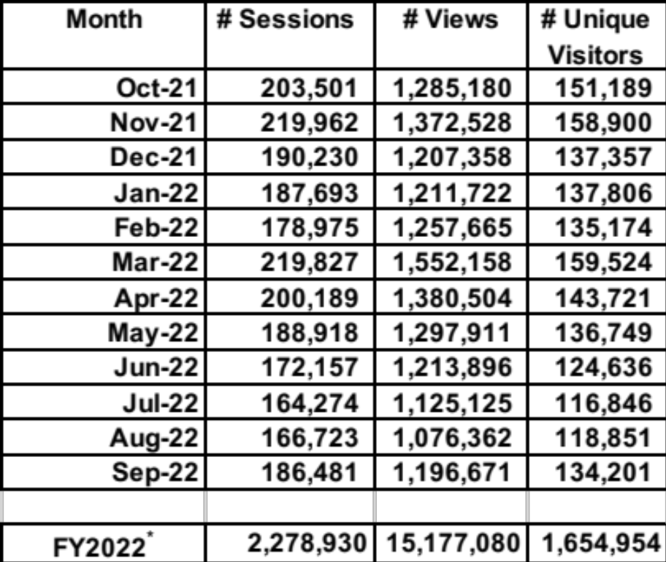
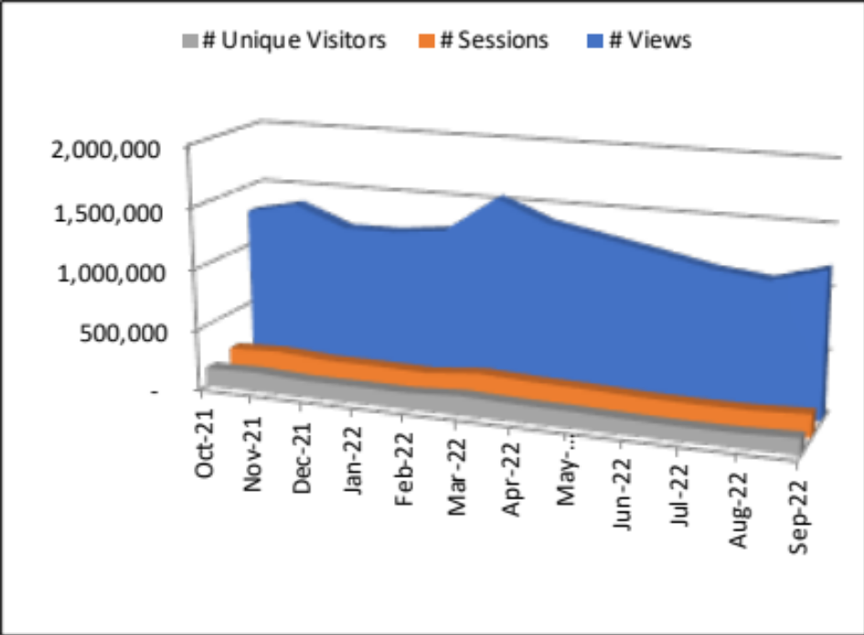
Web Visitors and Sessions
EOSDIS web activity is measured by number of Sessions made, the number of pages Viewed and the number of distinct Visitors. Sessions of at least one minute are considered to represent significant work accomplished, and many of the shorter sessions are of less than a second. All twelve EOSDIS DAACs report web metrics at this time. Note that the sum of monthly visitors could be greater than the number of unique visitor for a given year since one user could be counted more than once if he/she visited the same website in different months. Excludes Earthdata and LANCE website activity.
Google Analytics
* Represents the sum of the metrics from all 12 DAACs and excludes Earthdata.

Slide 34
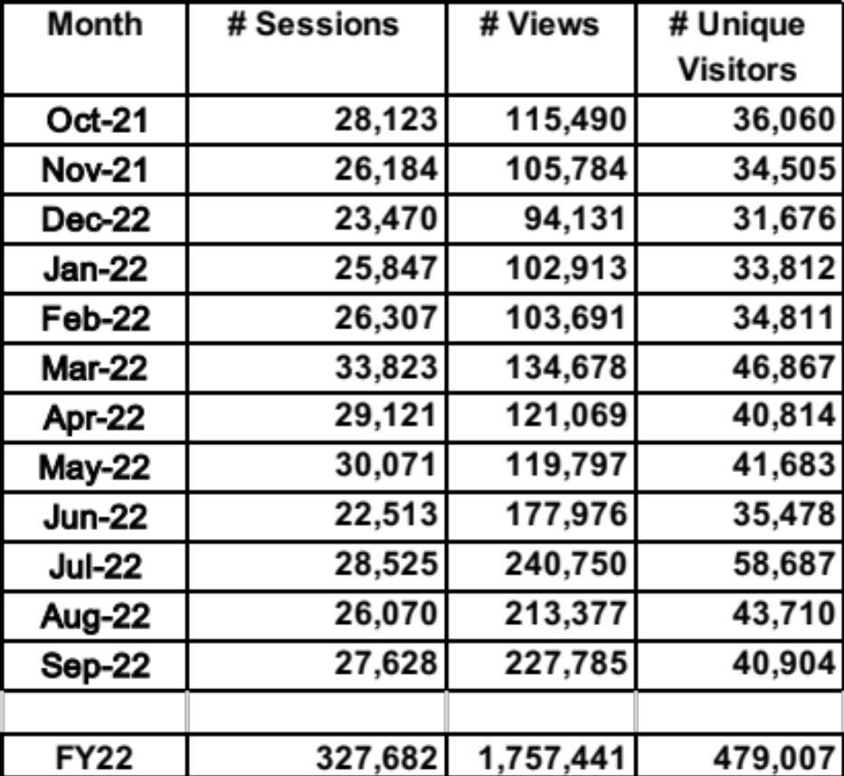
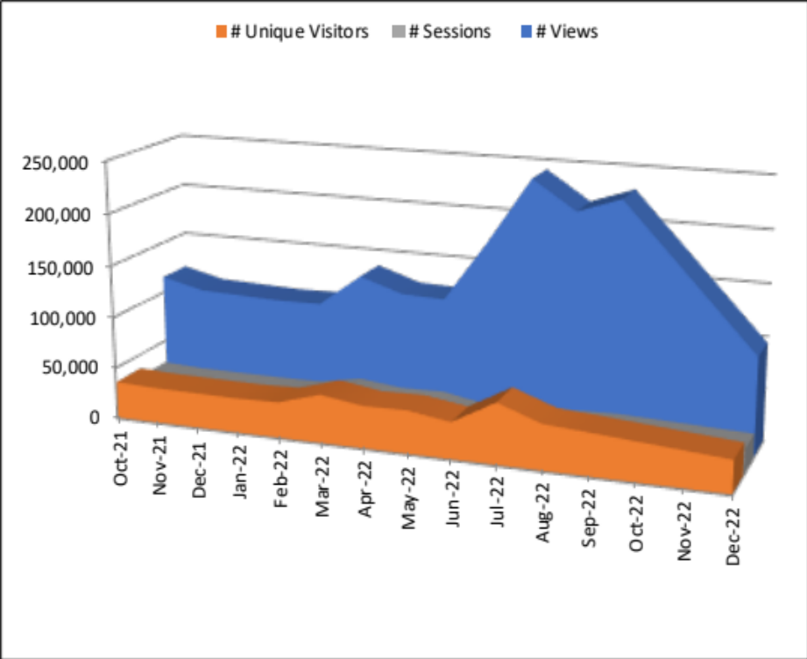
Earthdata Web Visitors and Sessions
EOSDIS web activity is measured by number of Sessions made, the number of pages Viewed and the number of distinct Visitors. Sessions of at least one minute are considered to represent significant work accomplished, and many of the shorter visits are of less than a second. This is for Earthdata website only. Note that the sum of monthly visitors could be greater than the number of unique visitor for a given year since one user could be counted more than once if he/she visited the same website in different months.
Google Analytics

Slide 35
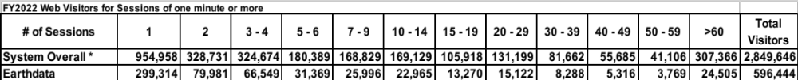
Repeat Web Visitors
EOSDIS Web Visitors are characterized by the number of sessions they make and how frequently they return. Visitors counted in the table below are those that stayed for one minute or more. Repeat Visitors are counted from the start of the Fiscal Year. Metrics data is collected per data center and summed for an EOSDIS total.
FY2021 Web Visitors for Sessions of one minute or more
Google Analytics
represents the sum of the metrics from all 12 data centers and excludes Earthdata and LANCE
Repeat users In Google Analytics, if a user has multiple sessions during the computation time period that user will be
counted for all sessions grouped that are applicable to that user

Slide 36
Top 20 Domains By # of Web Visitors
Google Analytics
No Such Report
IPaddress not available

Slide 37
Earthdata Top 20 Domains By
# of Web Visitors
Google Analytics
No Such Report
IPaddress not available

Slide 38
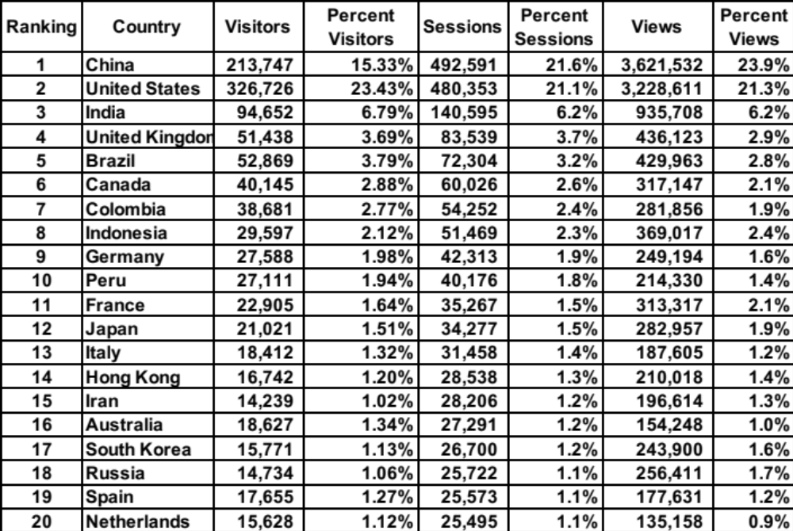
Top 20 Countries By # Web Visits
The FY2022 Top 20 Countries for sessions >= 1 minute is sorted by the # of sessions. Data came from 12 DAACs and excludes Earthdata and LANCE website. Country information is based on the Google Analytics Geolocation Service.
Google Analytics

Slide 39
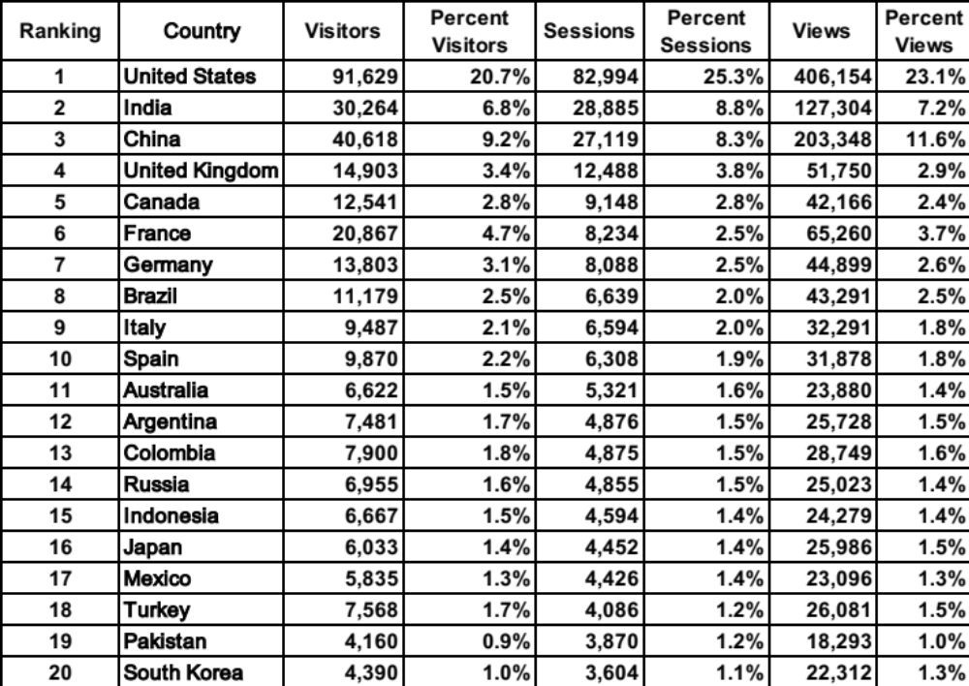
Earthdata Top 20 Countries By
# Web Visits
The FY2022 Top 20 Countries for sessions >= 1 minute is sorted by the # of Sessions. Country information is based on the Google Analytics Geolocation Service.
Google Analytics

Slide 40
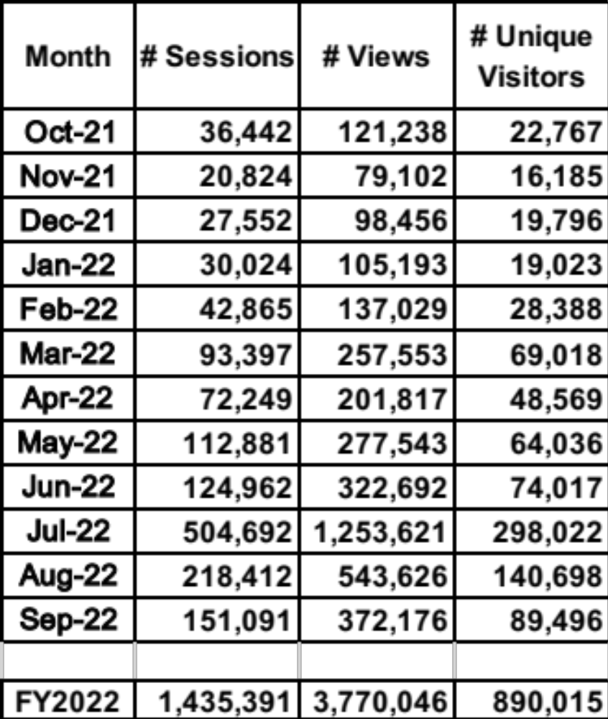
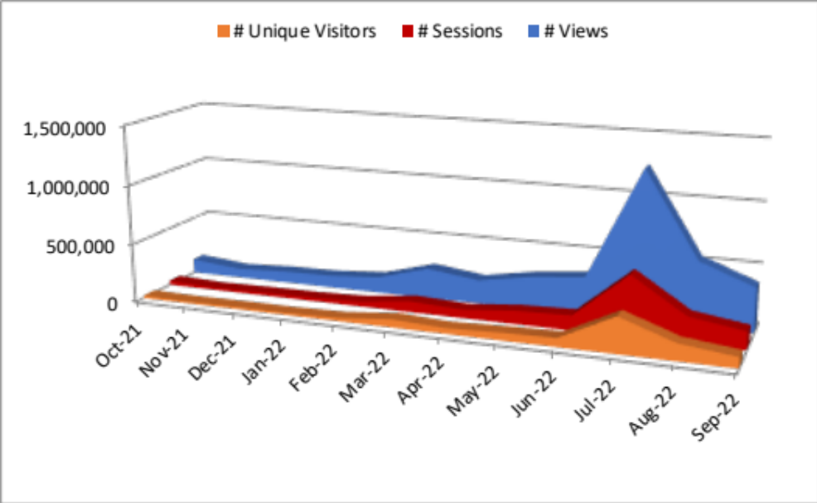
LANCE Web Metrics
LANCE web activity is measured by number of sessions made, the number of pages viewed and the number of distinct visitors for the LANCE website.
Google Analytics
40

Slide 41
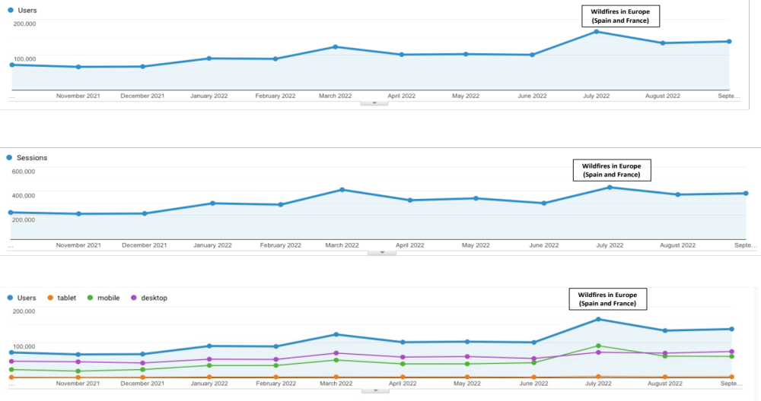
Worldview Web Metrics
Sessions represent the number of users who accessed the data download feature as opposed to total number of visitors. An event is any on-page action other than loading a page. If the target has more to do with interacting with the page or performing an on-page action,like entering form data, starting a video or making a selection choice, then it should be defined as an event.
Google Analytics
Graph 1: Worldview - Main, Users
Graph 2: Worldview - Main, Sessions
Graph 3: Worldview - Main, Device Type
41

Slide 42
Total Users and Trends
Total Users
Total Archive Trend
Data Volume Distribution Trend
Data Product Distribution Trend
Data Products by Product Level
Top 10 Products Trend FY2019 - FY2021
Known U.S. - Foreign Product Distribution Trend
Web Trends (Visits and Visitors)

Slide 43

Total Users
Total Users is an estimate formed by combining the distinct Data Users and distinct Web Visitors without removing the overlap (web and Data) and excludes LANCE Unregistered users who downloaded browse imagery. Web Visitors included in the count are for those visitors with sessions of one minute or longer. To minimize the undercount, the final Total Users value includes the total Web Visitors (IP address plus browser), plus the distinct Data Users.

Slide 44


Total Archive Trend
The total archive trend is based on data and reports produced during individual fiscal years, rather than from EMS. EMS does not contain sufficient information to recreate the archive size for previous years due to episodic deletions from the archive and not all archive information is supplied to EMS by the DAACs. Since products are deleted at the DAACs and not always reported to EMS, It may not be able to completely reproduce what was in the archive in previous years.
The trend data were compiled in FY2013 with the expectation it will be updated yearly with data captured in that year's EOSDIS Annual Report in the Total Archive Size worksheet. The sources of data for earlier years, which are not presented here, are available from the Excel version of this report.

Slide 45

Data Volume Distribution Trend
The Volume Distribution Trend presents distributed volume counts from EMS by DAAC. OBPG distribution metrics from the Ocean Color web site are included beginning in FY2004. CDDIS data became available in FY09.

Slide 46

Data Product Distribution Trend
The Product Distribution Trend presents distributed product counts from EMS by DAAC. OBPG distribution metrics from the Ocean Color web site are included beginning in FY2004. CDDIS data became available in FY2009.

Slide 47


Data Product Distribution Trend by Product Level
The Product Distribution Trend by Product Level presents distributed product counts from EMS by product level and includes NRT data products
¹ Other, these products have not been assigned any product level.

Slide 48

Top 10 Products Trend by Volume
FY2021 – FY2022
*Some products are inherently larger than other files in size and therefore may skew the results.
** Does not include metadata files

Slide 49

Top 10 Products Trend by # of Files
FY2021 – FY2022
** When counting # of files, metadata files are not included.

Slide 50

U.S. – Foreign
Product Distribution Trend
* product distribution where the destination could not be determined

Slide 51

Web Trends
Web metrics data for EOSDIS became available as of FY2007, Data for FY2007 is complete for 7 DAACs and FY2008 is complete for 8 DAACs. Since FY2009, 11 DAACs provided webmetrics and from FY 2020 all 12 DAACs have provided the webmetrics data. For FY 2007 to FY 2018 NetInsight data was used, for FY 2019 both NetInsight and Google Analytics data was used, while as from FY 2020 only Google Analytics data was used as the Netinsight was decommissioned from Oct 1, 2019. These web metrics excludes Earthdata & LANCE and are for sessions (visits) of one minute or more. Repeat visitors are counted as 2 or more visits since web activity measurements began for that DAAC.
Google Analytics

Slide 52

Earthdata Web Trends
Web metrics data for Earthdata became available as of FY2012. These metrics are for sessions of one minute or more. Repeat visitors are counted as 2 or more sessions since web activity measurements began for that DAAC.
Google Analytics

Slide 53
Earthdata Systems
Earthdata Login
CMR Collections/Granules
Earthdata Search Client
Earthdata Systems are some of the systems that are under EED-3 and provide metrics on the number of users registering with earthdata login and number of data collections and granules metadata provided by various data providers to the CMR. In addition earthdata search client utilization is provided by showing number of sessions and acquisitions.
Provided by EED-3 Staff

Slide 54

Earthdata Login
The Earthdata Login provides a single mechanism for user registration and profile management for all EOSDIS system components (DAACs, Tools, and Services). Earthdata Login also helps the EOSDIS program better understand the usage of EOSDIS services to improve user experience through customization of tools and improvement of services. Given the utilization of Earthdata Login across EOSDIS system components, Earthdata Login metrics provide one measure of interest in NASA earth science holdings.
This year marked the achievement of a major milestone for Earthdata Login: 1 million users, which occurred in November 2021. The total number of Earthdata Login registered users increased by 24.3% over the course of FY2022 (compared to a 22.1% during FY2021), from 969,300 at the beginning of October 2021 to 1,205,209 by the end of September 2022.
The number of new users registered weekly in Earthdata Login varied seasonally, approximating 5,000/week during the school year, with smaller numbers during the summer and year-end holidays. The number of new registered users ranged from a low of 2,086 for the week ending 1/3/22 to a high of 5,909 the week ending 3/28/2022, with an average of 4,625 new users per week ( New Users by Week chart).

Slide 55

CMR Collections
The Common Metadata Repository (CMR) is a high-performance, high-quality, continuously evolving metadata system that catalogs all data and service metadata records for the EOSDIS system and is the authoritative management system for all EOSDIS metadata. These metadata records are registered, modified, discovered, and accessed through programmatic interfaces leveraging standard protocols and APIs.
The number of total collections, or data set series, holdings in CMR increased by 4.52% in FY 2022, from 53,073 at the beginning of the fiscal year to 55,470 at the end of the fiscal year. This is a significantly smaller increase than that of FY 2021 (49.6%).
The number of EOSDIS collection holdings in CMR increased by 14.2%, from 10,749 in October 2021 to 12,272 at the end of September 2022. This increase is slightly higher than that of FY 2021 (12.4%). The number of collections had a fairly steady upwards trend throughout the year.

Slide 56

CMR Granules
While collection metadata provides information about types of data stored in the CMR, granule metadata is the smallest aggregation of data which is independently managed (i.e., described, inventoried, retrievable). These are metadata elements that describe a single granule of a data product. Values of granule metadata apply to all of the data in that one granule. Typical metadata in this category describe spatial and temporal extent of the data as well as the quality and lineage of the data. of June 2021.
The number of granule holdings in CMR increased by 37.4%, from 858.5 million in October 2021 to 1.2 billion at the end of September 2022. This is a markedly higher than the FY2021 increase (20.7%).
FY2022 also marked the milestone of reaching one billion granules in the CMR; this milestone was achieved in June 2022. The following chart provides a weekly summary of the CMR granule holdings.

Slide 57

Earthdata Search Client
The Earthdata Search Client is the primary client for accessing NASA Earth Science data via the flagship earthdata.nasa.gov website. Utilization of the EDSC is measured in terms of the number of sessions, or visits by a user over a short period of time, to the site as well as by acquisitions, which represent the number of times data was downloaded via the EDSC.
EDSC showed steady utilization throughout FY2022 with an average of 15,617 sessions each week. EDSC sessions fluctuated throughout the year, with a low of 11,119 during the week ending 1/2/22, and a high of 18,684 during the week ending 4/24/22.
EDSC acquisitions likewise fluctuated throughout the year, with a high of 6,530 during the week ending 4/10/22, a low of 3732 during the week ending 1/2/22, and an average of 5,132 acquisitions per week.

Slide 58
DAAC Profiles
Individual DAACs
LANCE

Slide 59


Slide 60


Slide 61


Slide 62


Slide 63


Slide 64


Slide 65


Slide 66


Slide 67


Slide 68


Slide 69


Slide 70


Slide 71


Slide 72


Script ran at Mon Oct 10 19:45:01 2022
FY22 Daily Data Availability with EMS for Ingest, Archive, and Distribution as provided by the Data Providers

Slide 73

Definitions (1 of 3)

Slide 74

Definitions (2 of 3)

Slide 75

Definitions (3 of 3)

